Slide 1
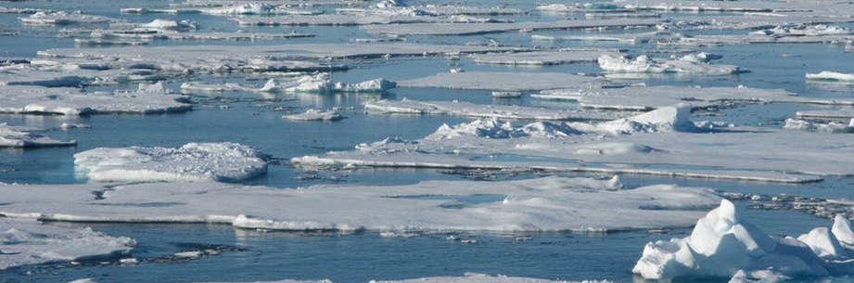
Antarctic sea ice and Southern Ocean Simulations using the ACCESS-CM2 model
Sea ice results in ACCESS CM2 and ACCESS ESM1.5 and links to SIMIP.
Siobhan O’Farrell, CM2 modelling team, ESM modelling team,
special thanks to Arnold, Sullivan, Chloe Mackallah
Climate Science Centre, CSIRO Ocean and Atmosphere

Slide 2
Outline
Engagement with SIMIP and AntClim21 papers for IPCC deadline.
Arctic sea ice change, sea ice/snow budgets, Antarctic projections, SAM, ASL, SH zonal jet changes
The difference in sea ice schemes between models
Results from CM2 (historical, and scenarios)
Time series results from CM2 v observations
Results from ESM1.5 (historical and scenarios)
Conclusions

Slide 3
Ice model scheme differences
ACCESS CM2
ACCESS ESM1.5
CICE5.1.2
Based on GSI8 (UM)
Multilayer ice calculation in ice, surface ice/snow Temperature calculated in UM-JULES
Climate sensitivity 4.7ºC
CICE albedo scheme duplicated in JULES more so more realistic albedos than ESM.
CICE 4.1
Zero layer ice calculation, surface temperature calculation in UM.
Climate sensitivity 3.86ºC
Albedos based in UM radiation code, were retuned to highest possible observed values to counter CABLE warm NH bias in ACCESS1-3.

Slide 4
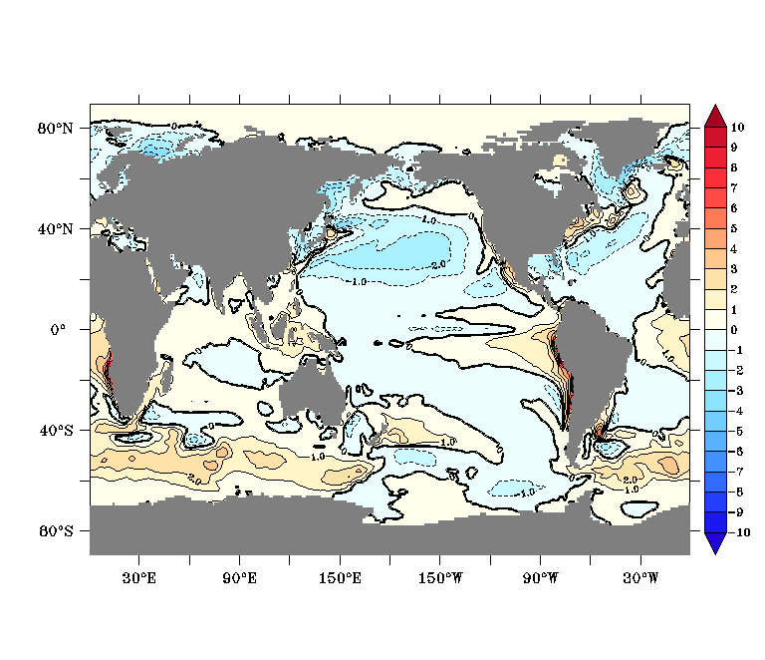
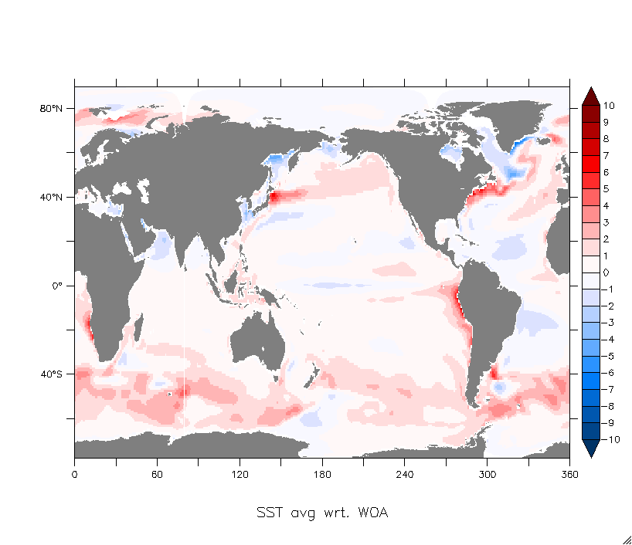
ACCESS CM2
ACCESS ESM1.5
SST Bias in respective model piControl
By Matt Chamberlain

Slide 5
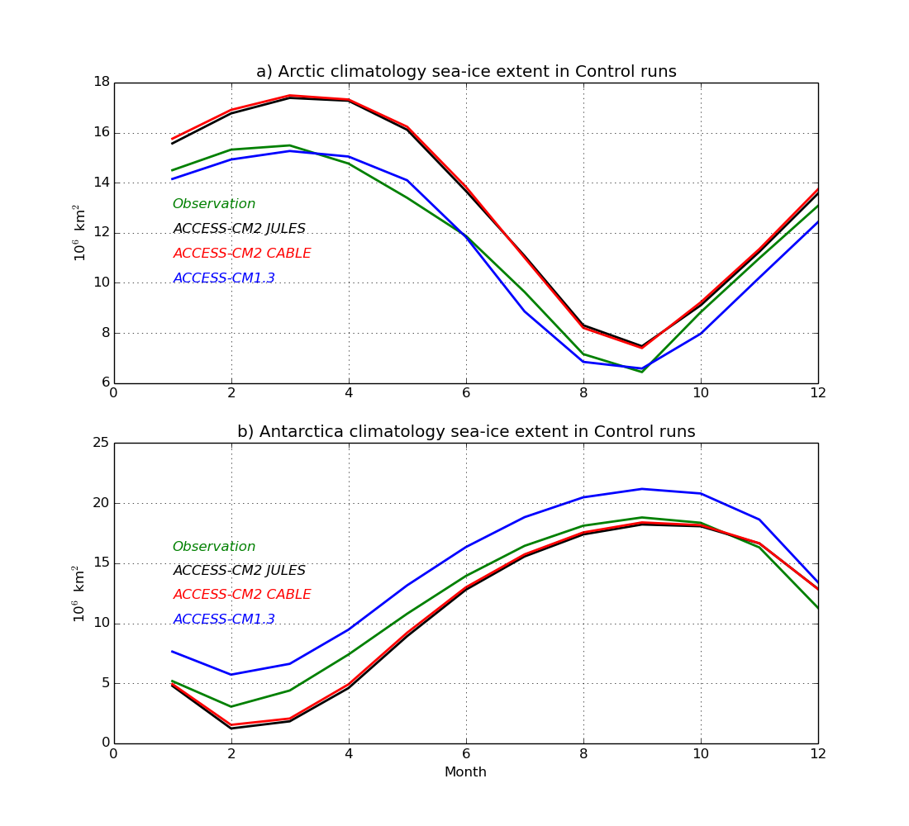
Pre-industrial control simulation ice extent climatologies for ACCESS CM2 and ACCESS 1.3 (analogue for ACCESS ESM1.5). (Observations are present day).

Slide 6
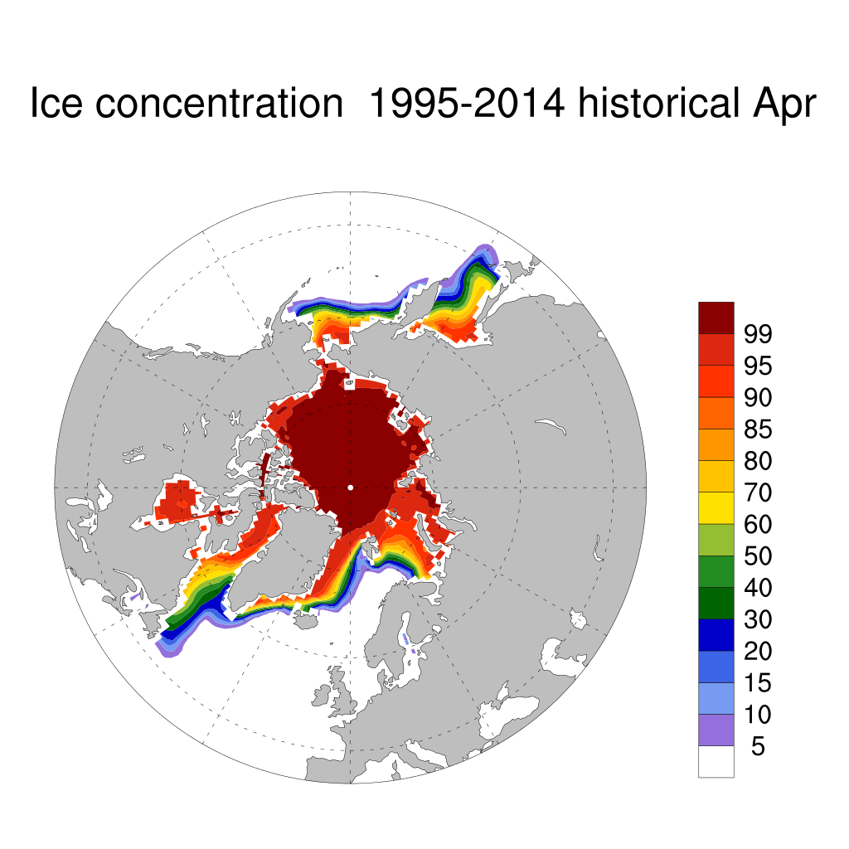
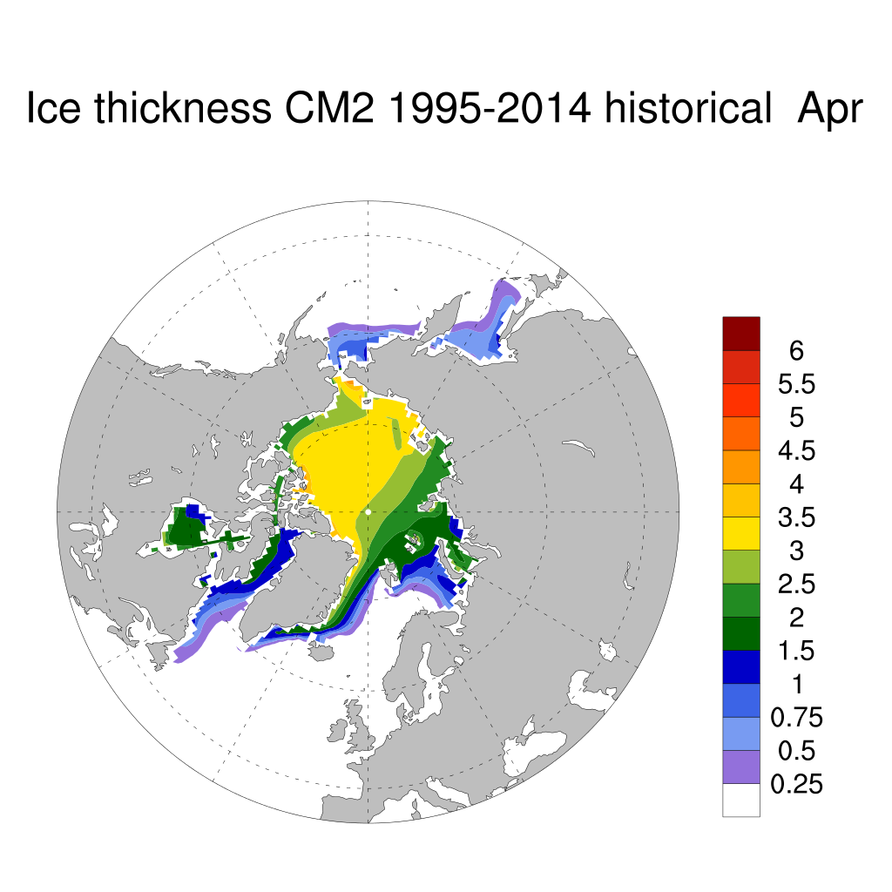
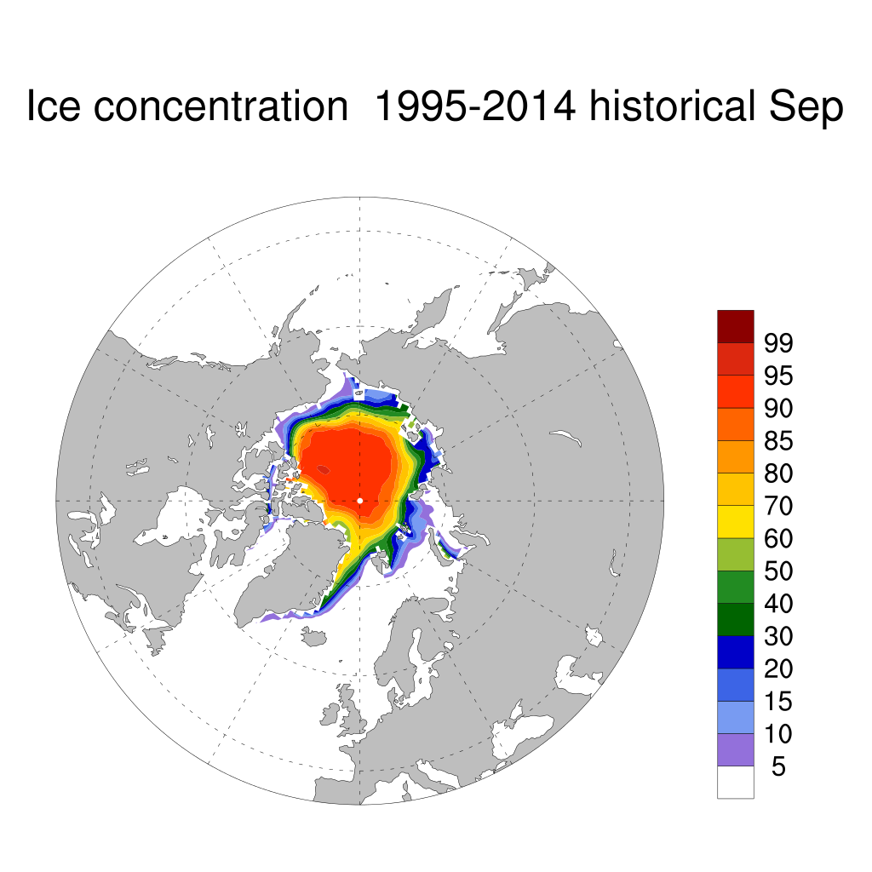
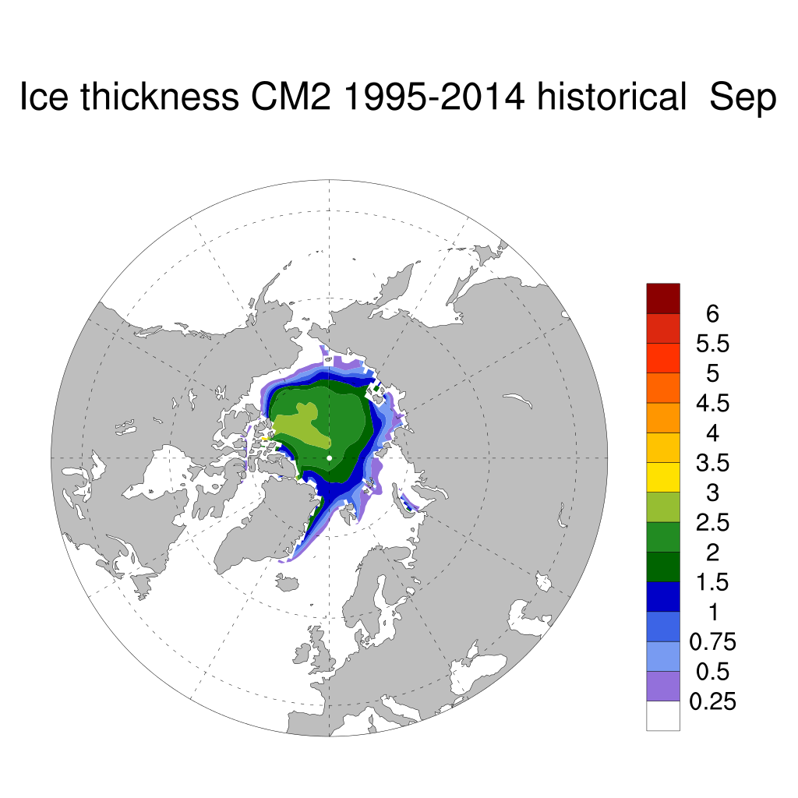
ACCESS CM2 historical NH ice climatology 1995-2014 (fairly similar to piControl not shown), Ice too extensive across central Arctic due to strong Beaufort High Pressure System. Ice bias in North Pacific sector due to model bias in the North Pacific region.

Slide 7
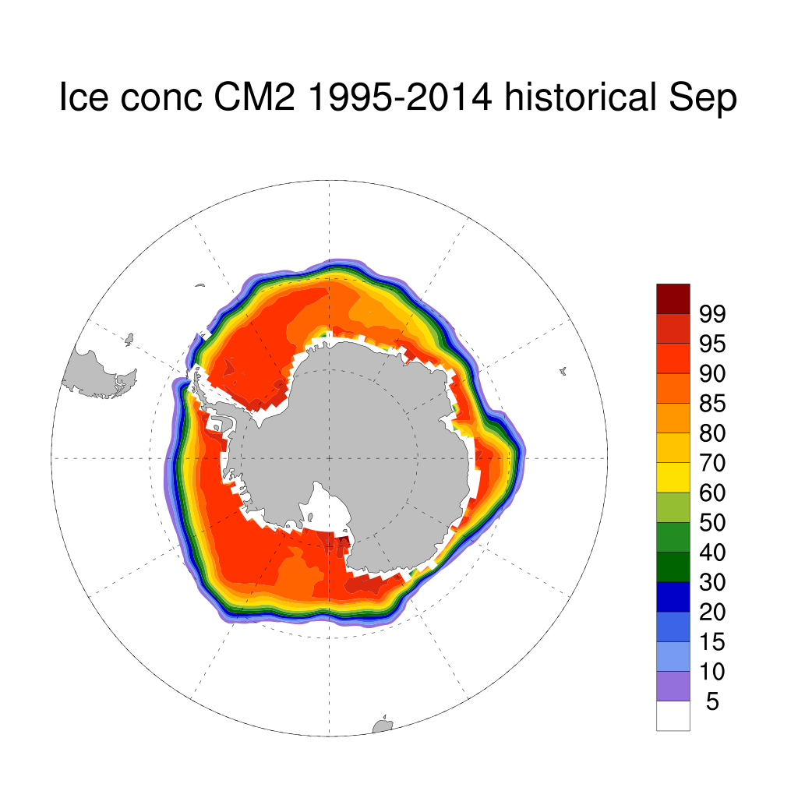
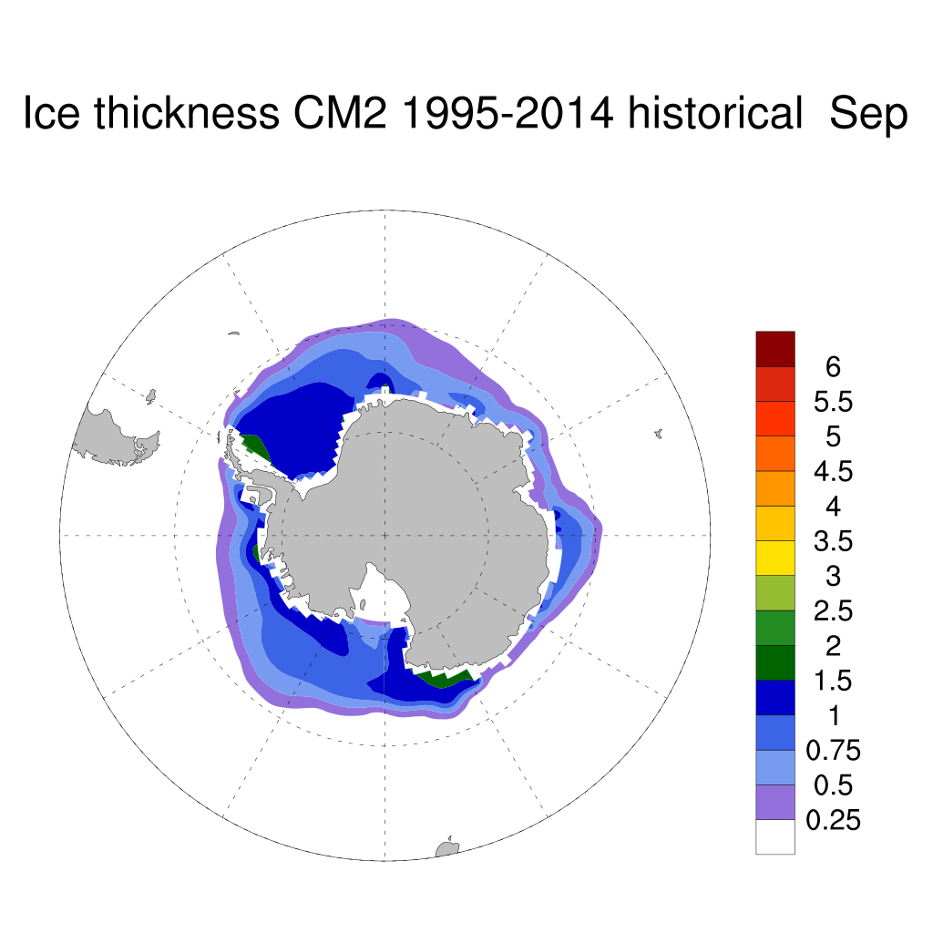
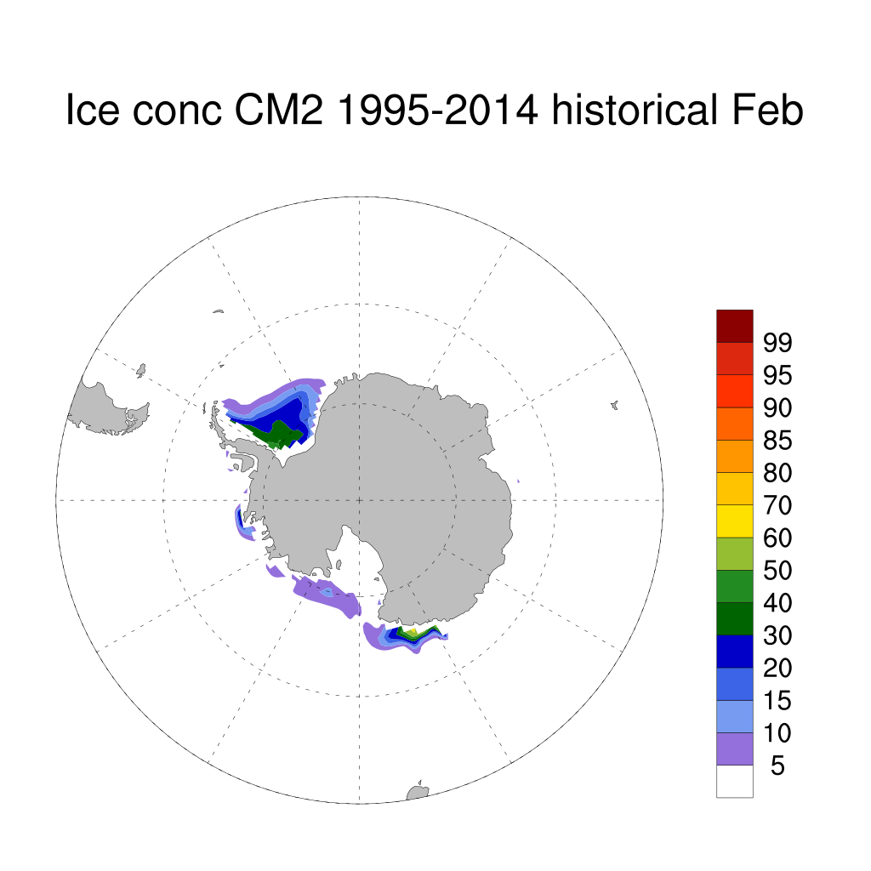
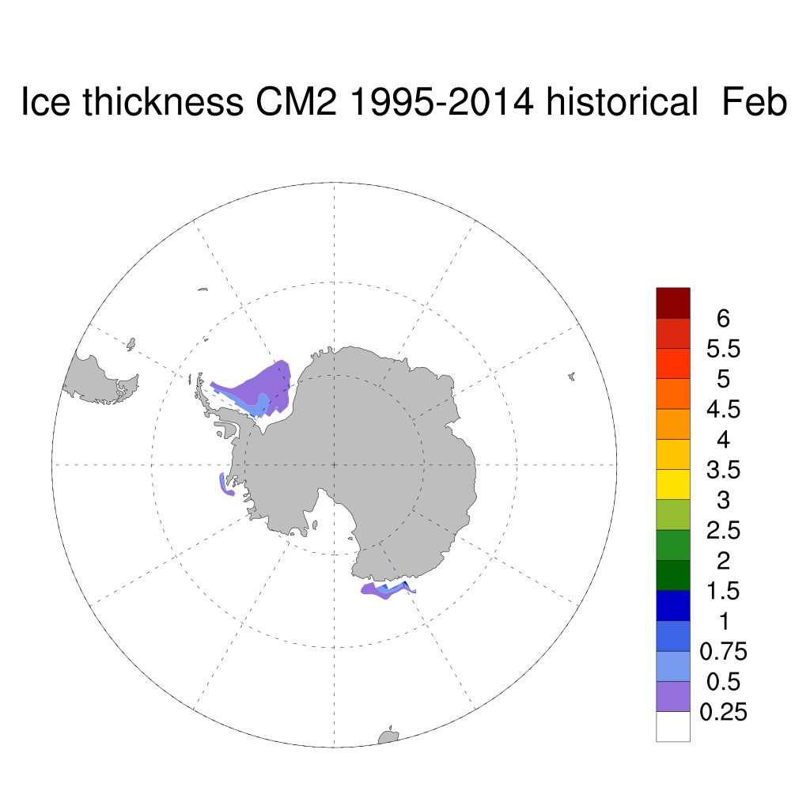
ACCESS CM2 SH historical ice climatology 1995-2014 (again very similar to piControl not shown). Ice thickness too thin and ice concentration at ice minimum too low.

Slide 8
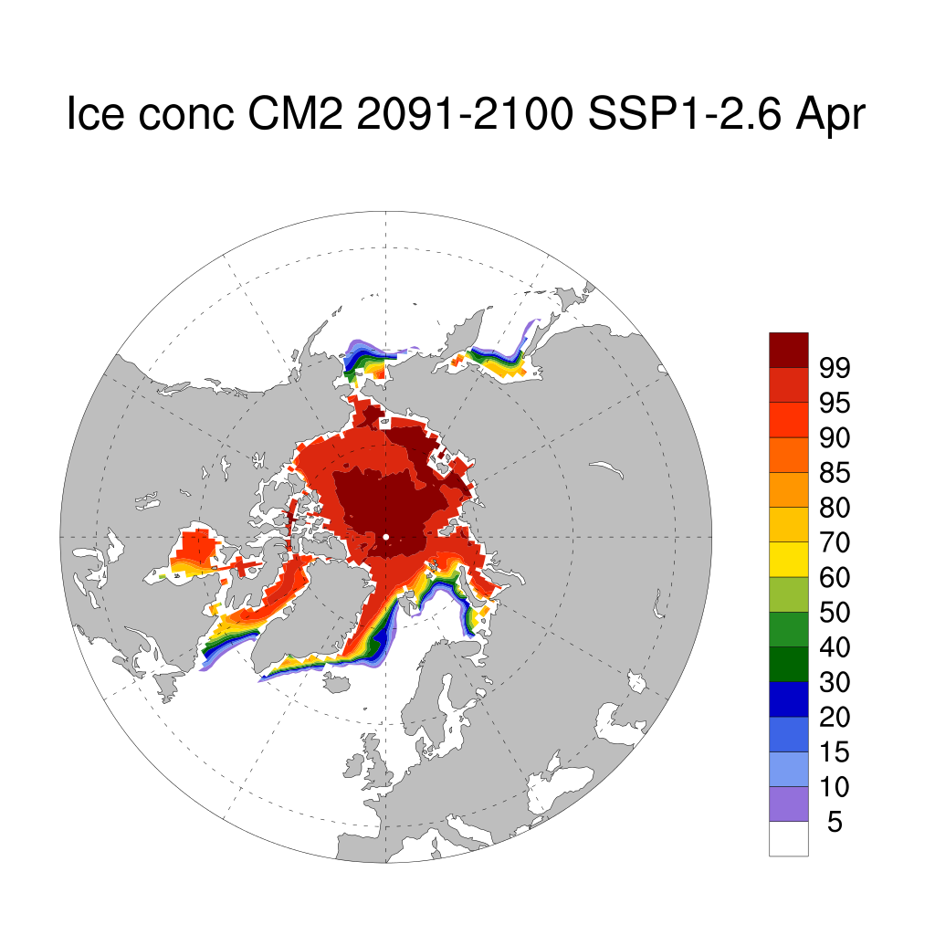
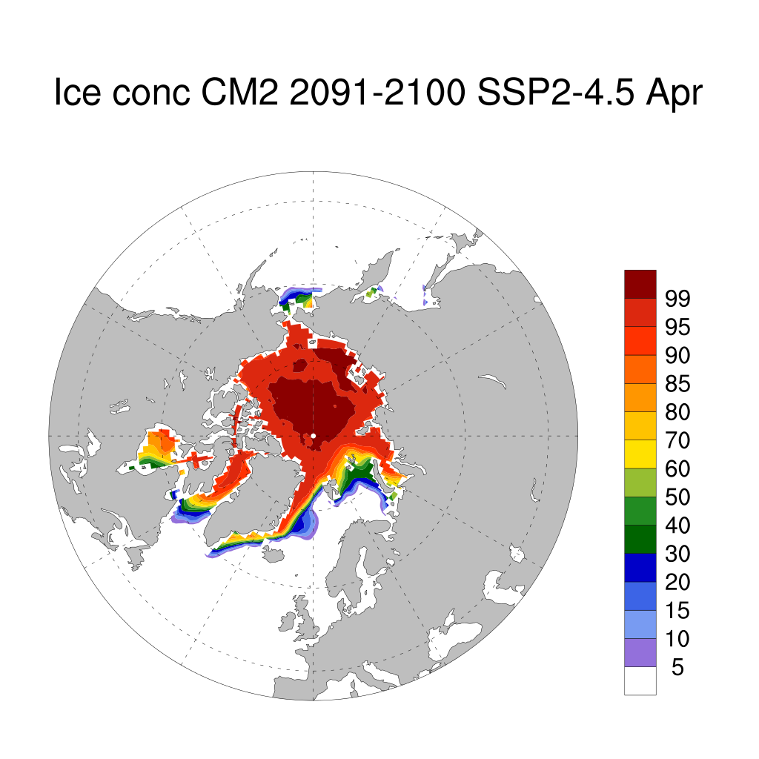
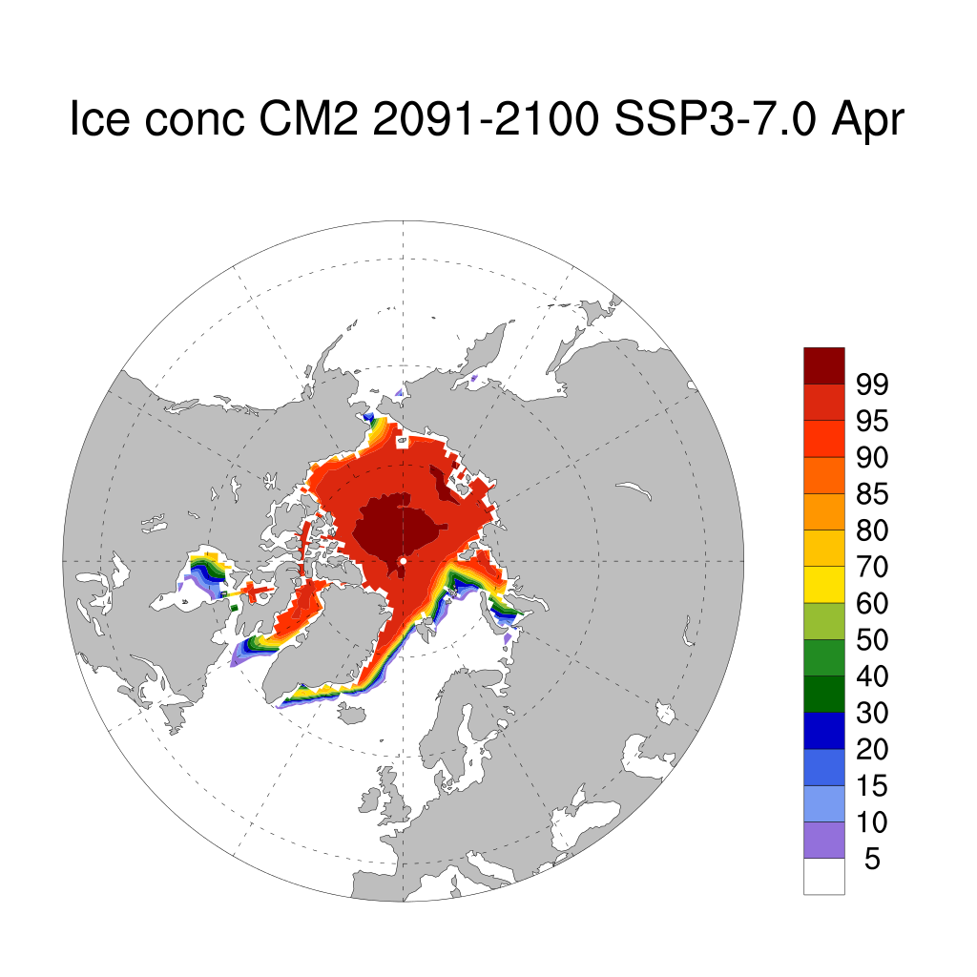
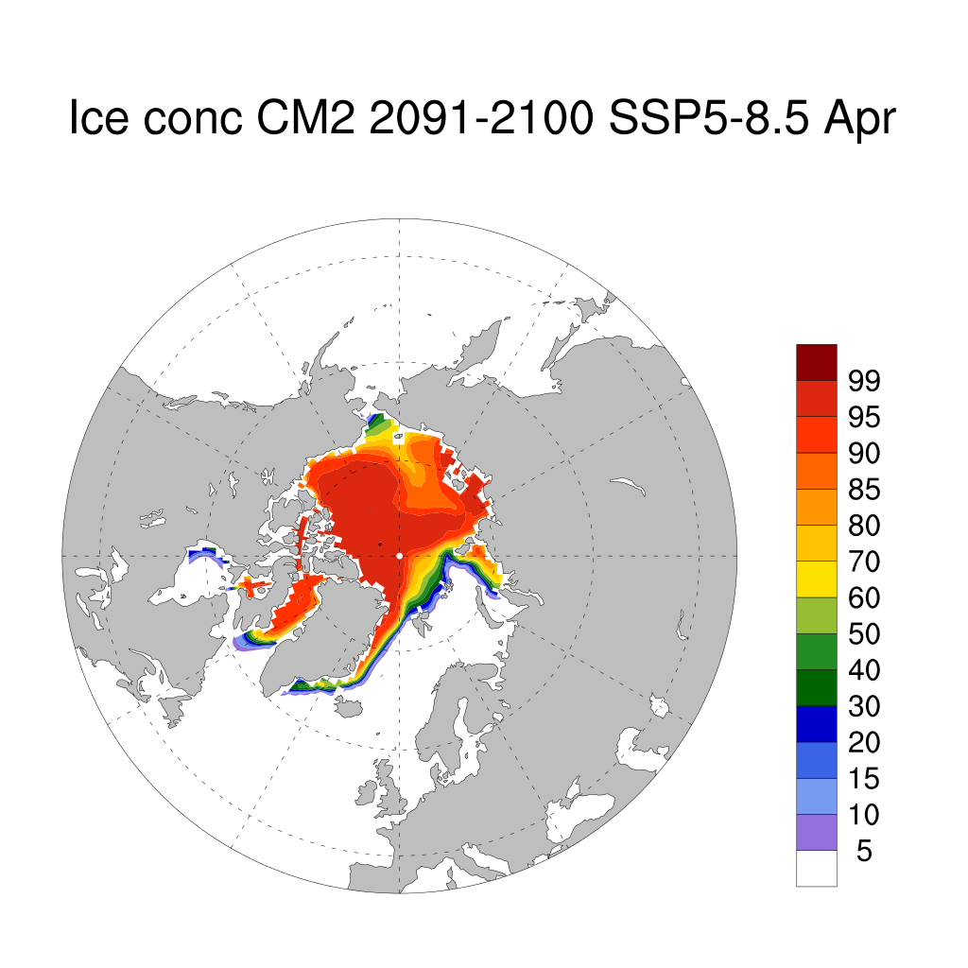
ACCESS CM2 Scenario runs April (late winter) ice concentration climatology 2091-2100. Lower Scenarios little change in central Arctic, change only in peripheral seas

Slide 9
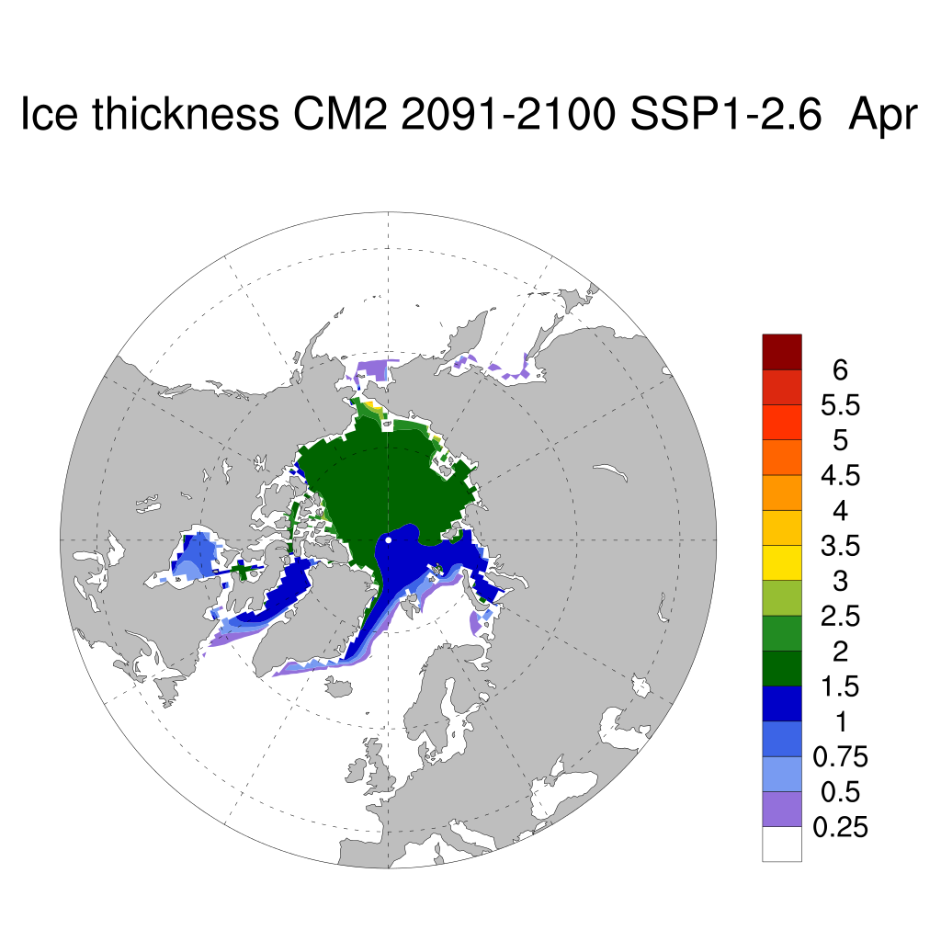
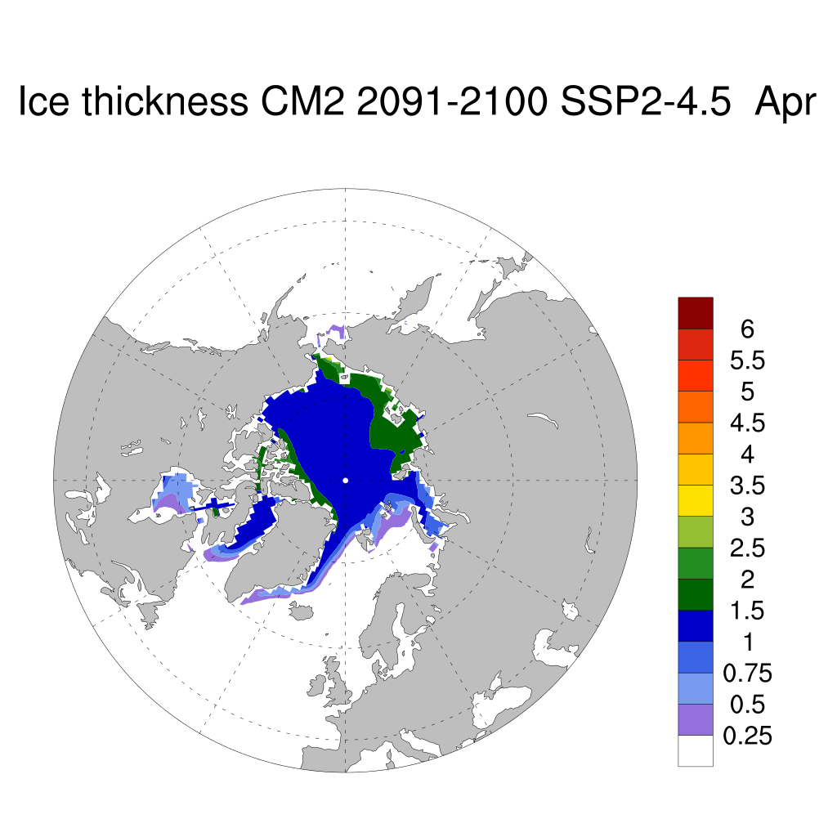
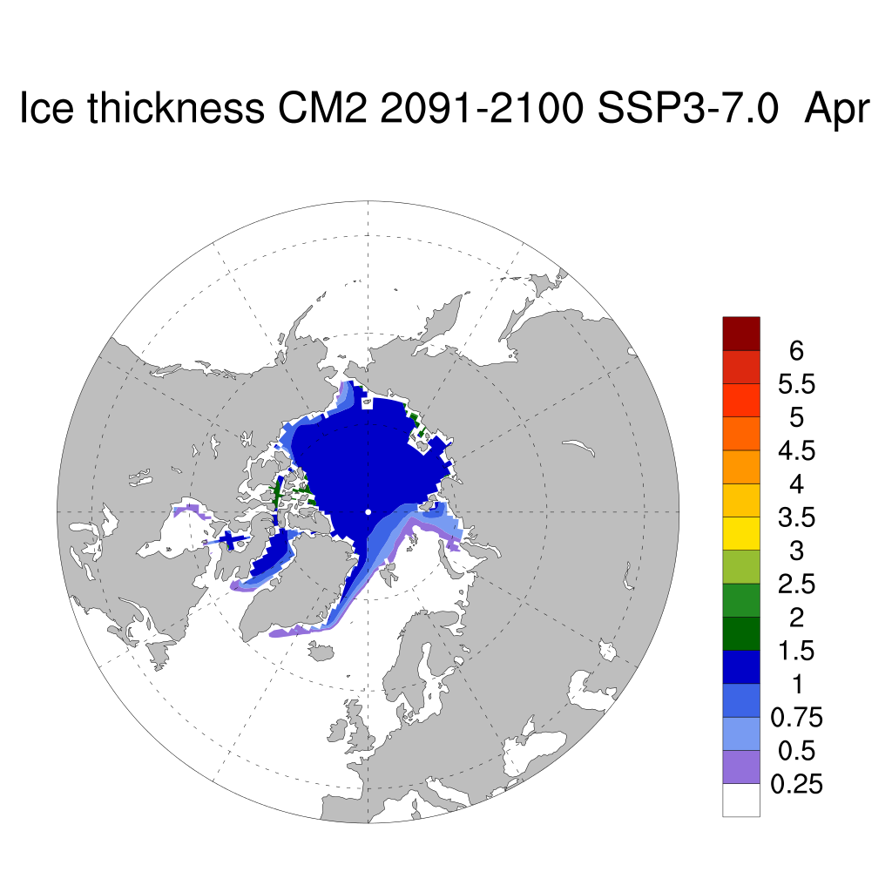
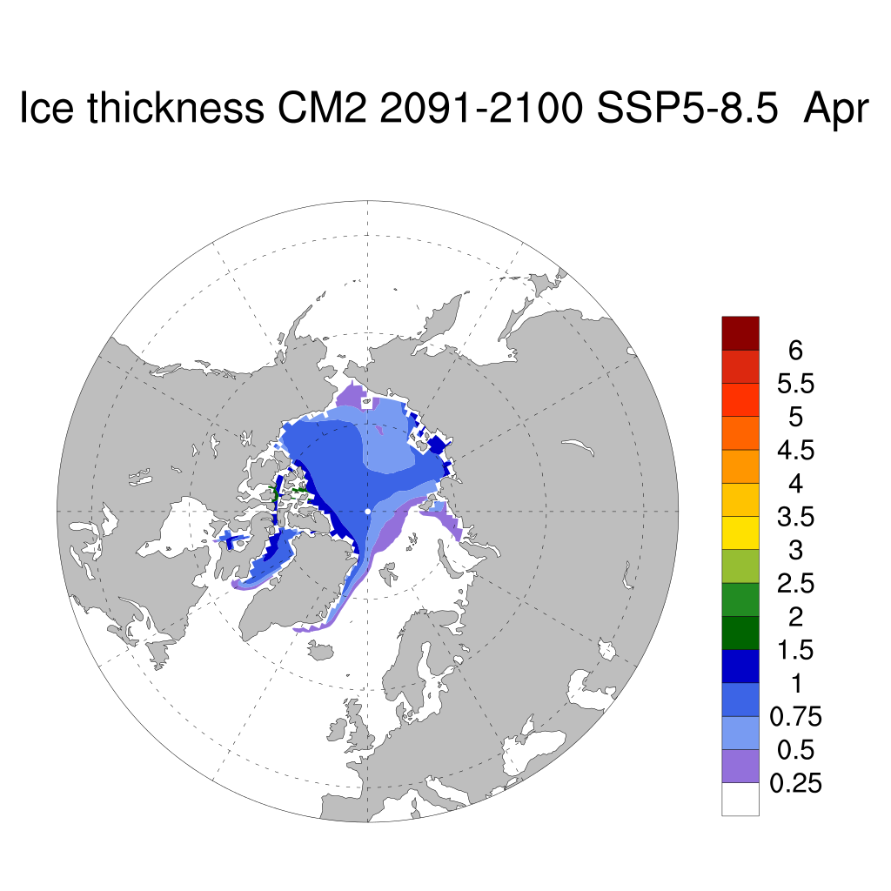
ACCESS CM2 ice thickness climatology for scenarios 2091-2100 April late winter) showing different ice growth rate for each scenario.

Slide 10
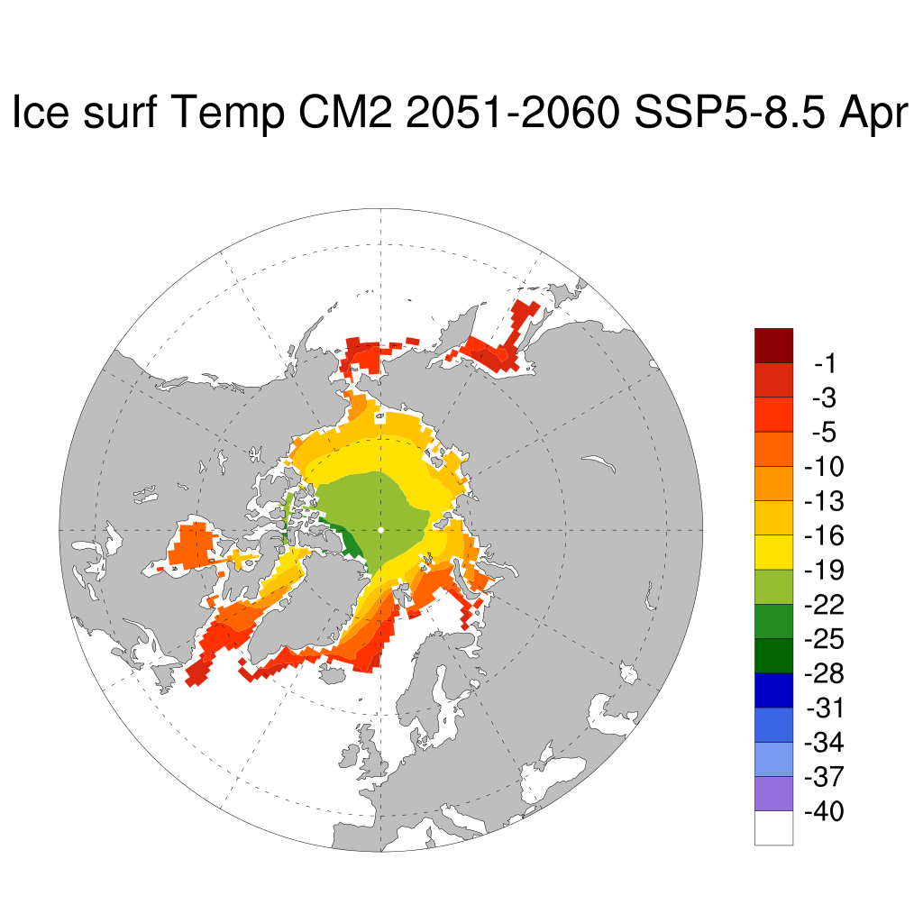
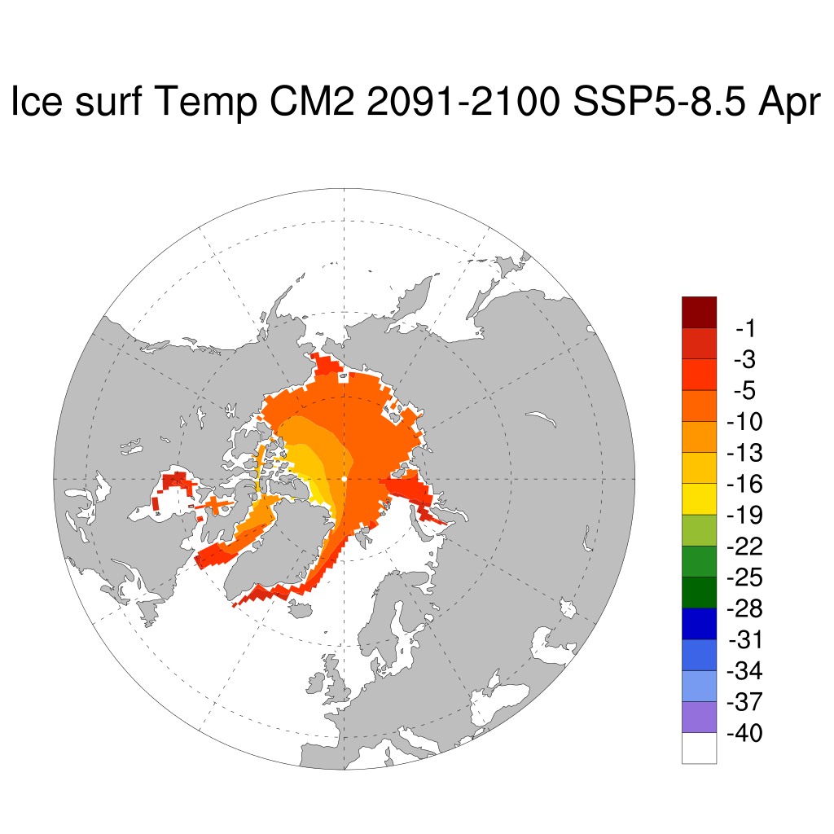
ACCESS CM2 SSP5-8.5 late winter ice temperatures on surface of snow/ice surface 2051-2060 and 2091-2100 periods.

Slide 11
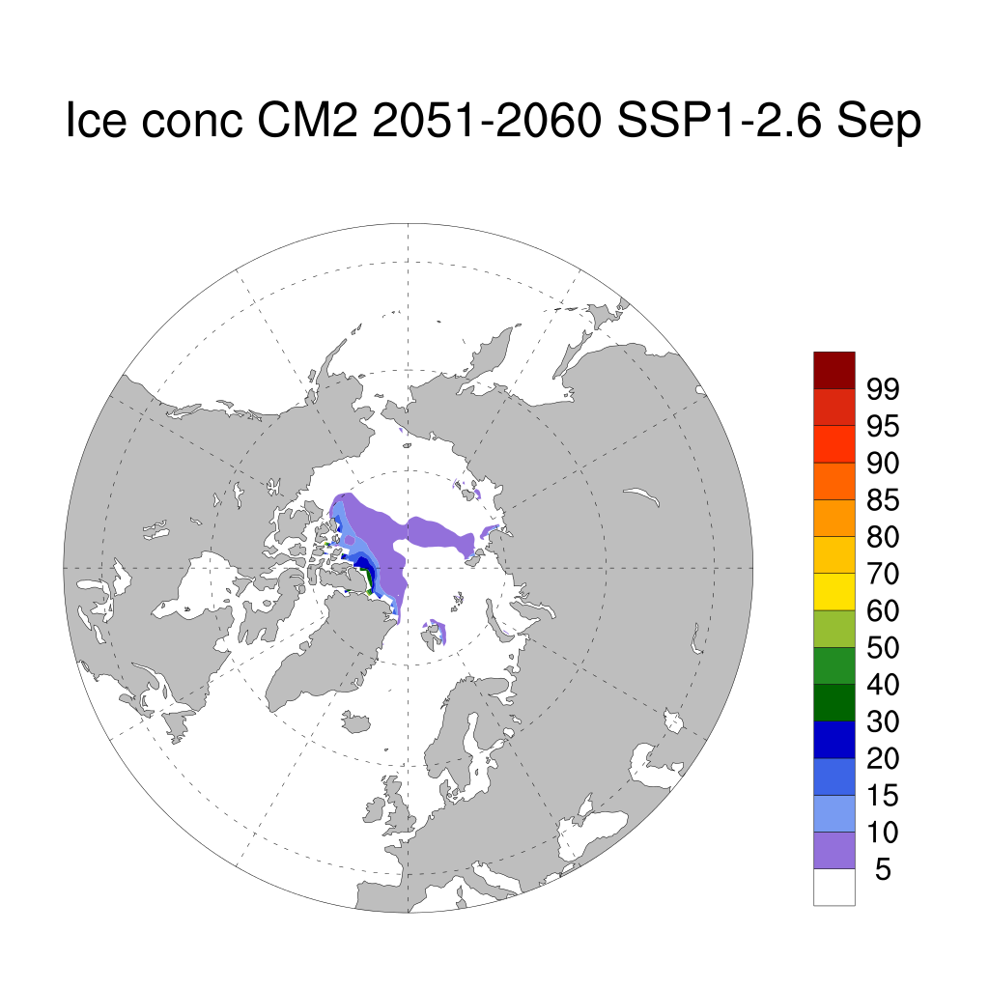
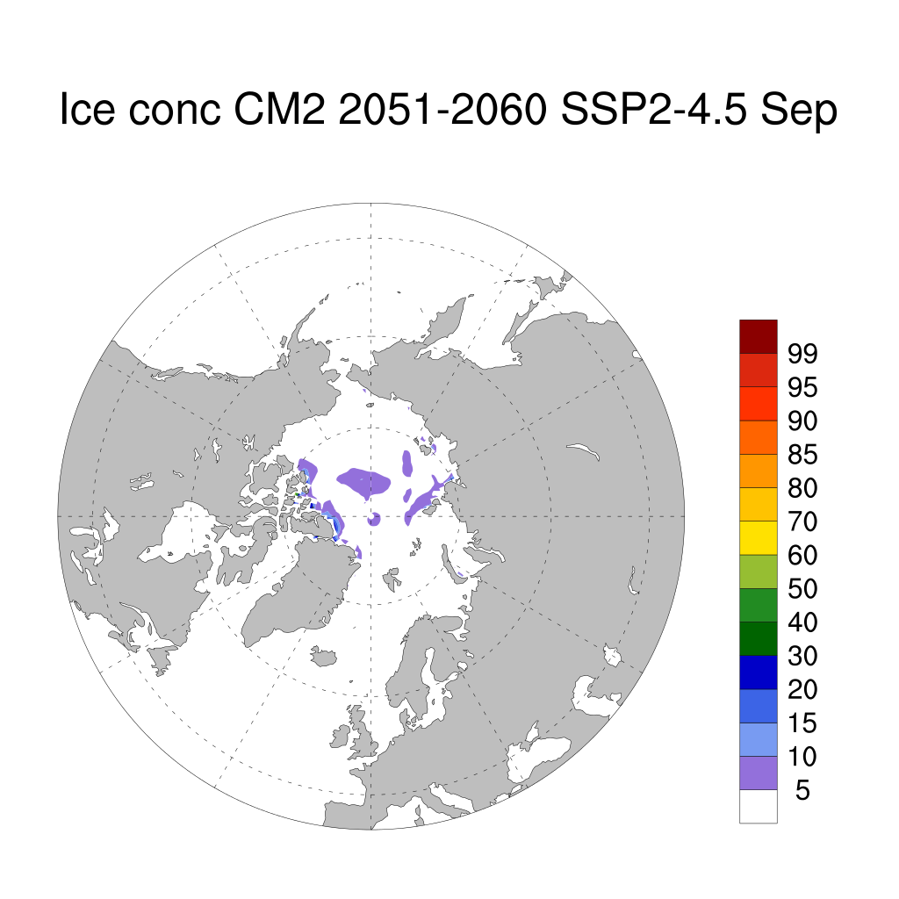
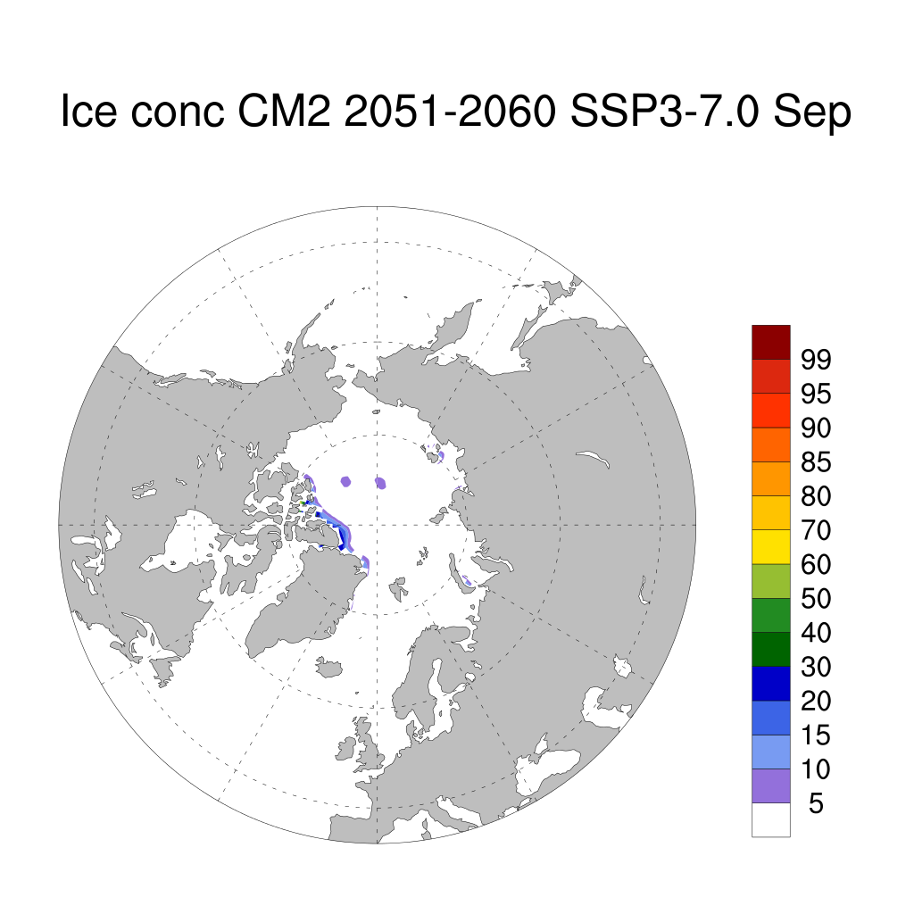
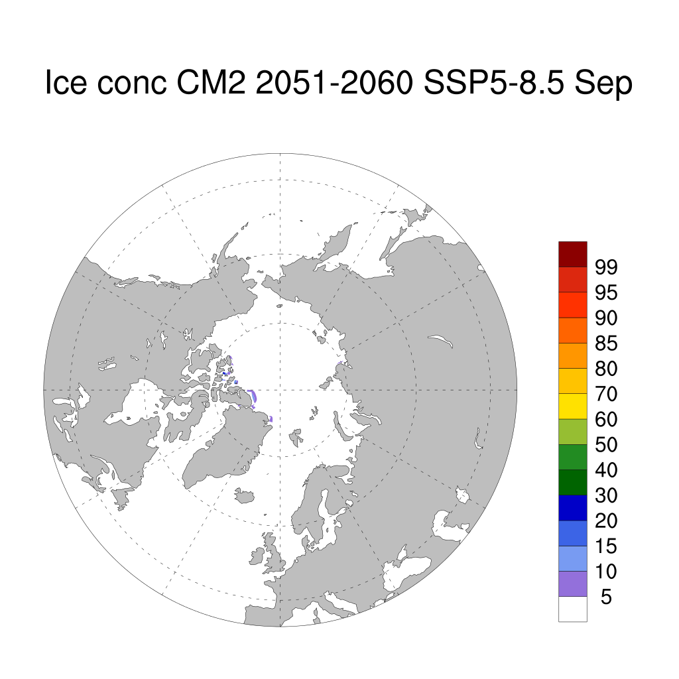
ACCESS CM2 ice concentration climatology for scenarios September (late Summer), 2051-2060. Already in most of the scenarios there is a large scale melt in the Arctic in all scenarios, With the similar changes in Global temperatures (Martin Dix talk) in the scenarios over the next few decades this should not be a surprise

Slide 12
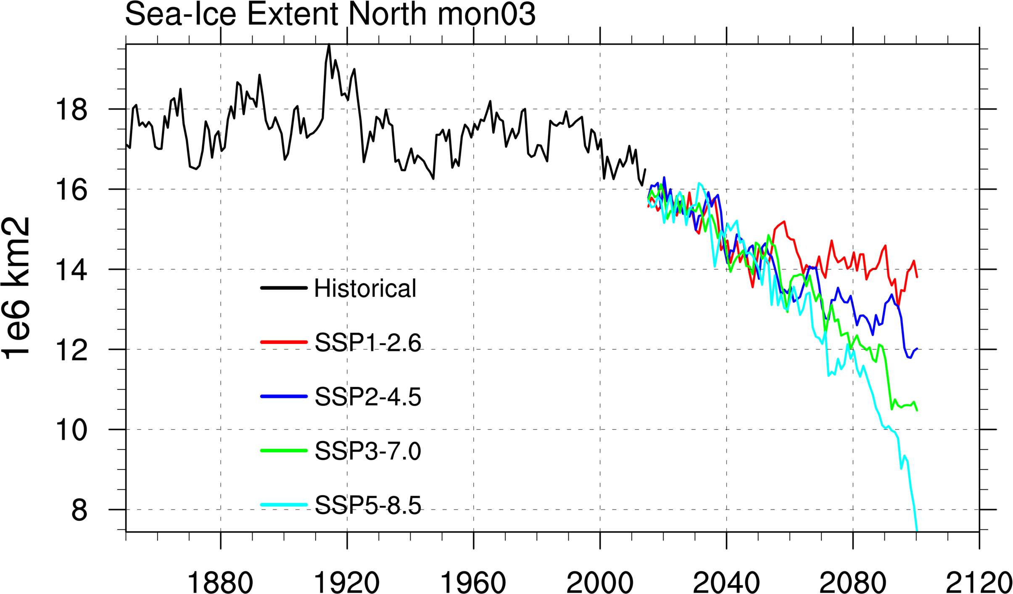
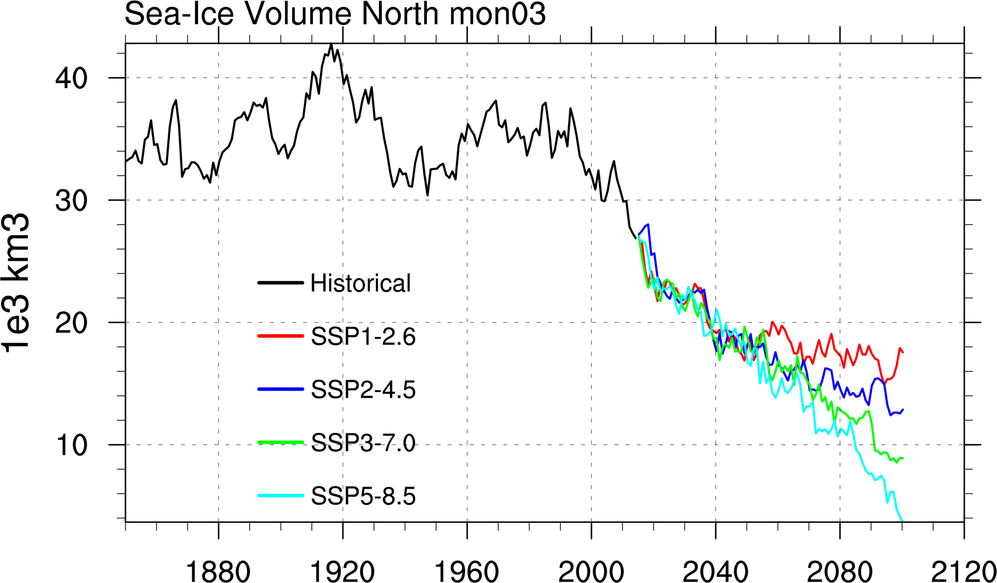
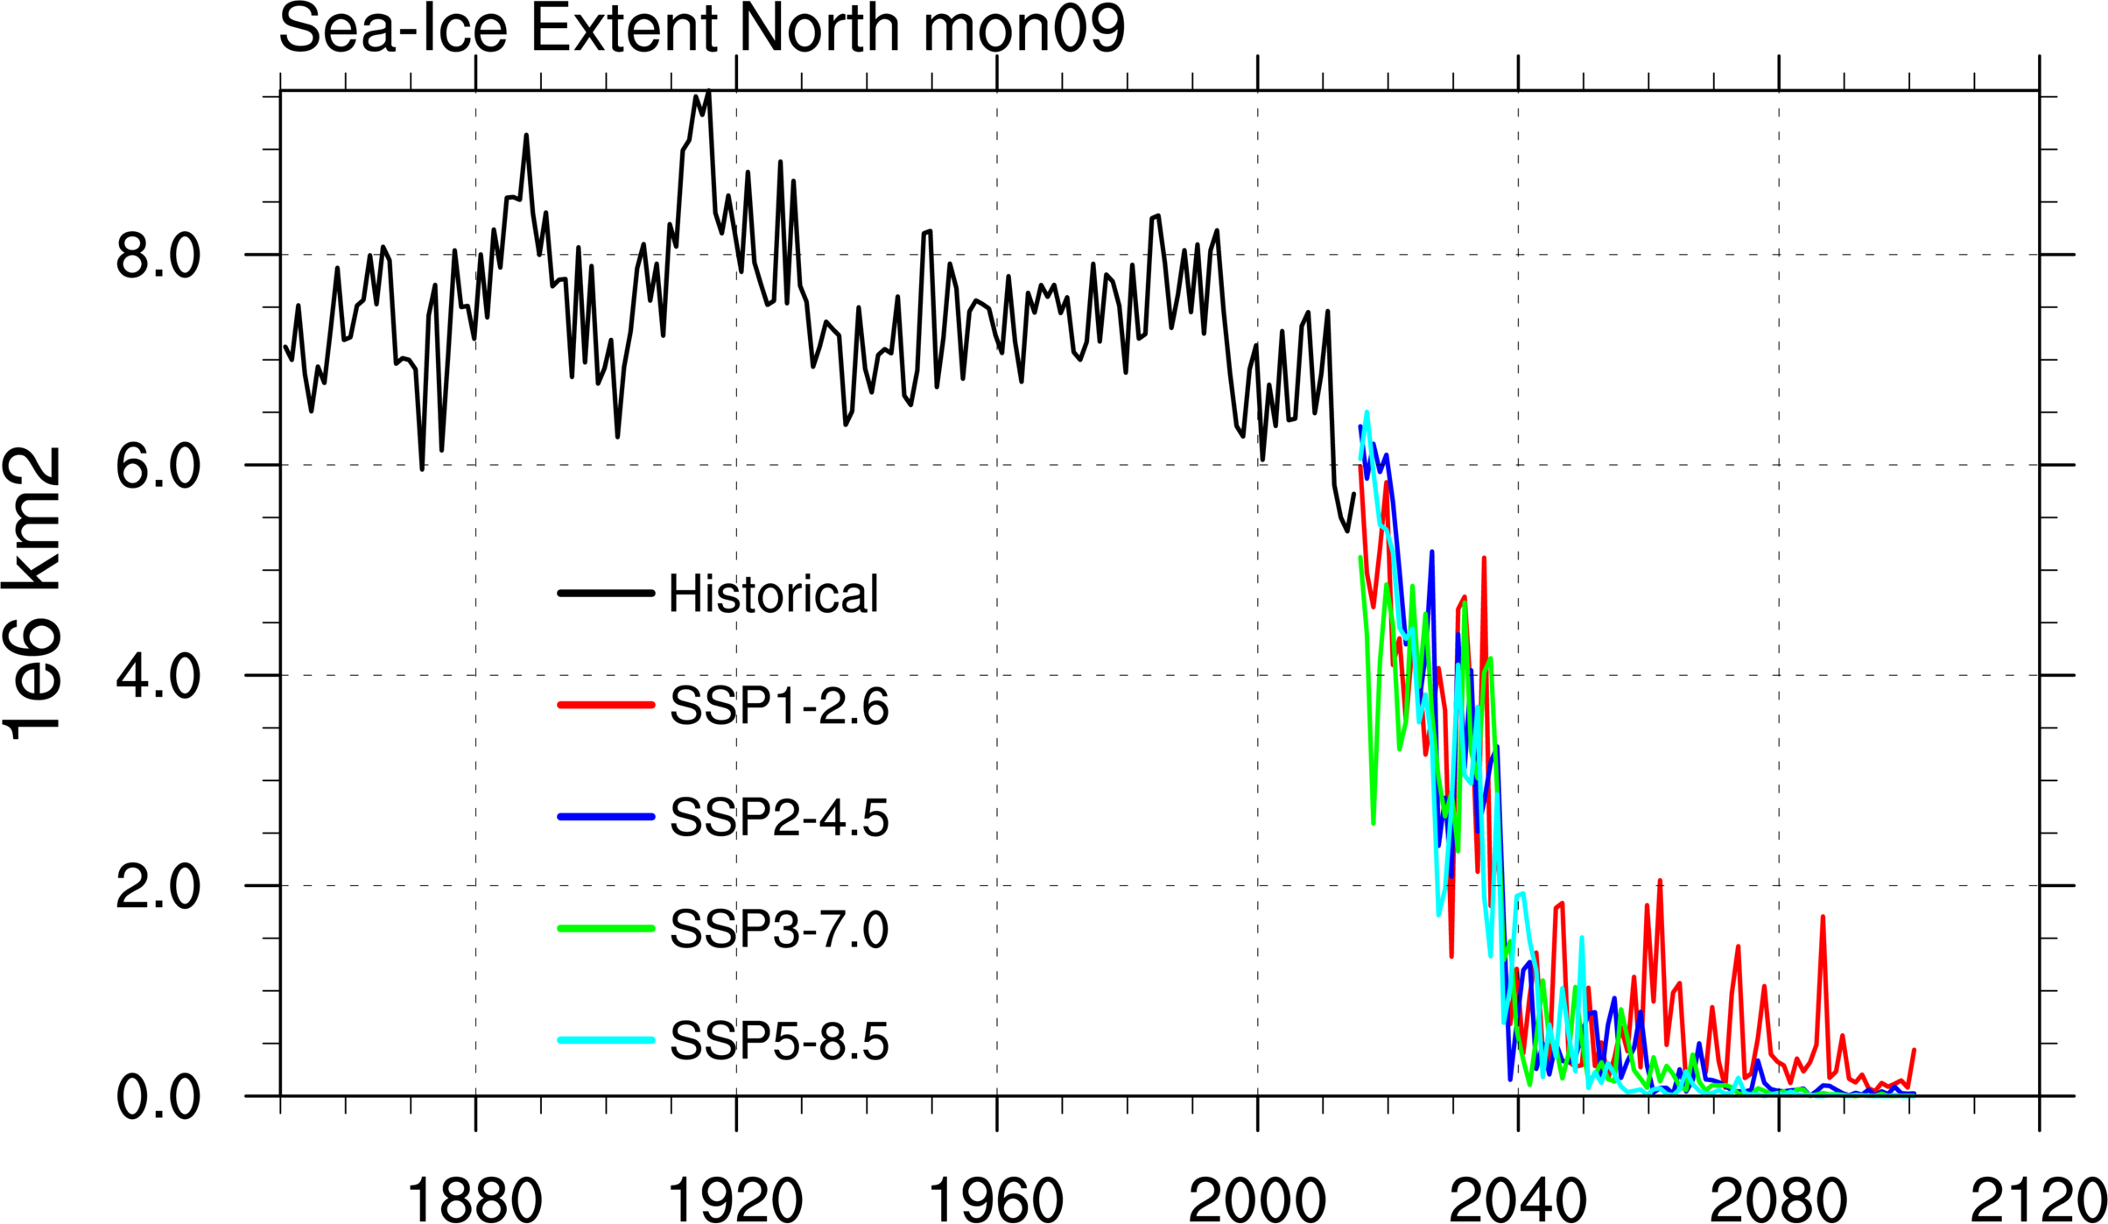
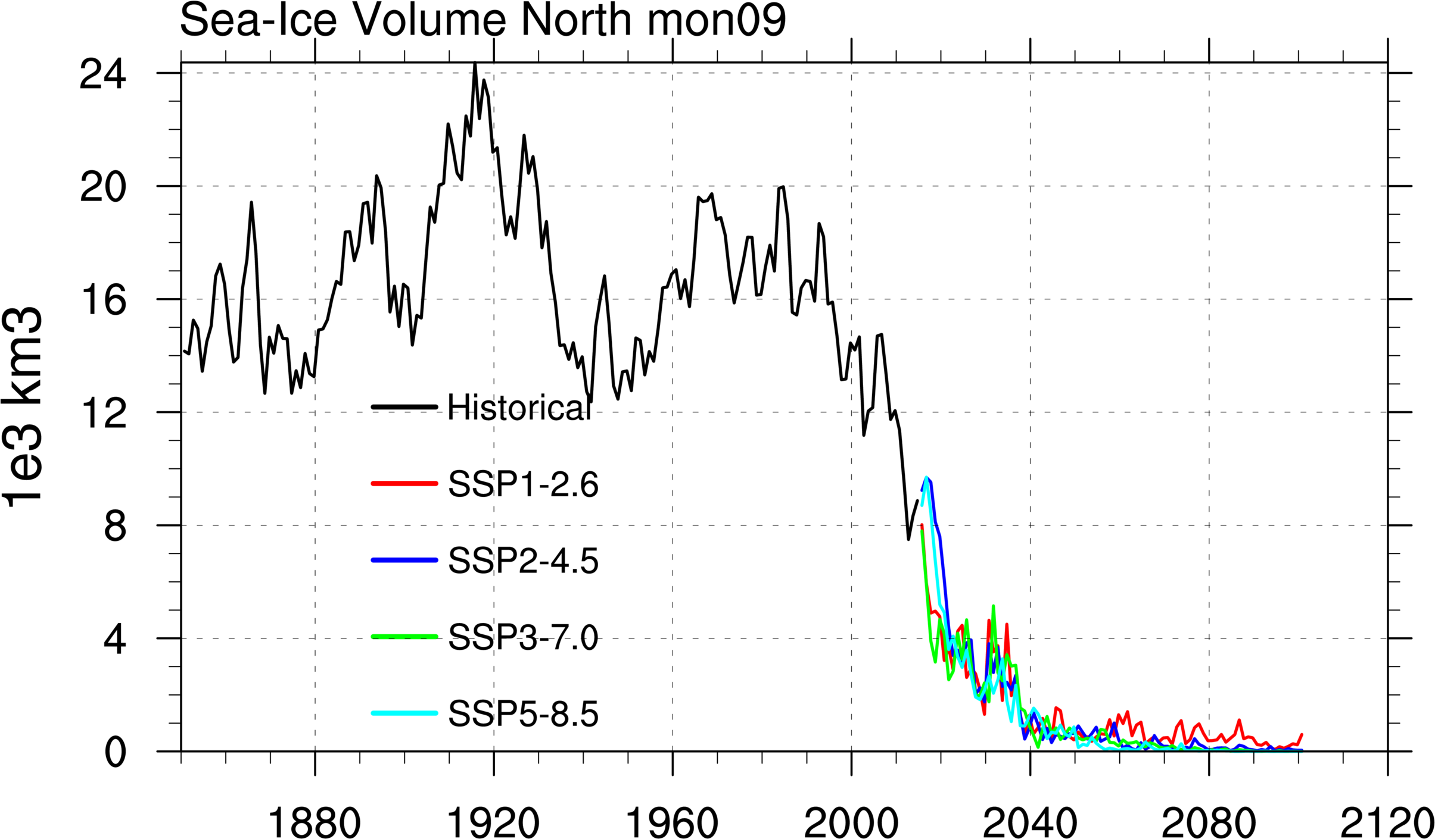
ACCESS CM2 sea ice time series ice extent and volume Northern hemisphere

Slide 13
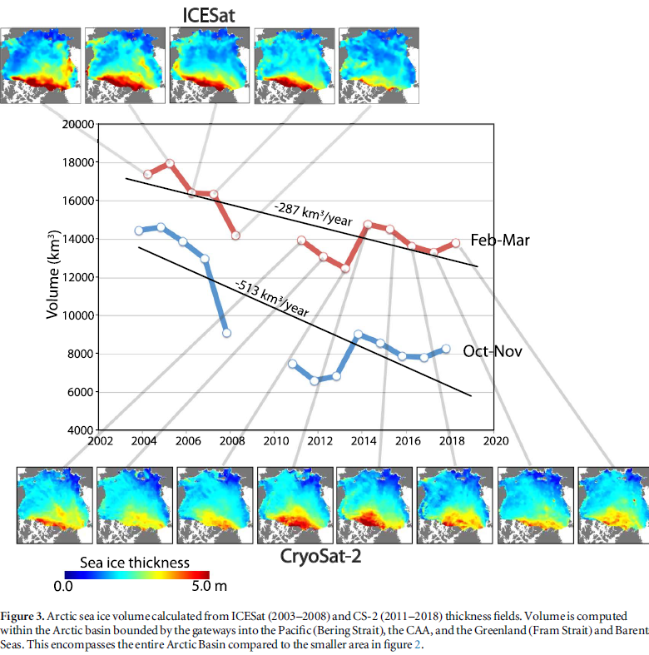
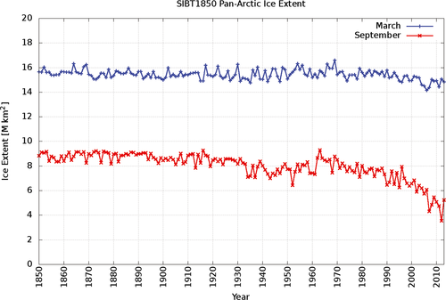
Observations on ice extent back to 1850 in the Arctic, using charts
A database for depicting Arctic sea ice
Variations back to 1850, Walsh et al, 2016.
Ice volume change in Arctic in 2 satellite periods, ICESat, Cryosat-2 Kwok, 2018.

Slide 14
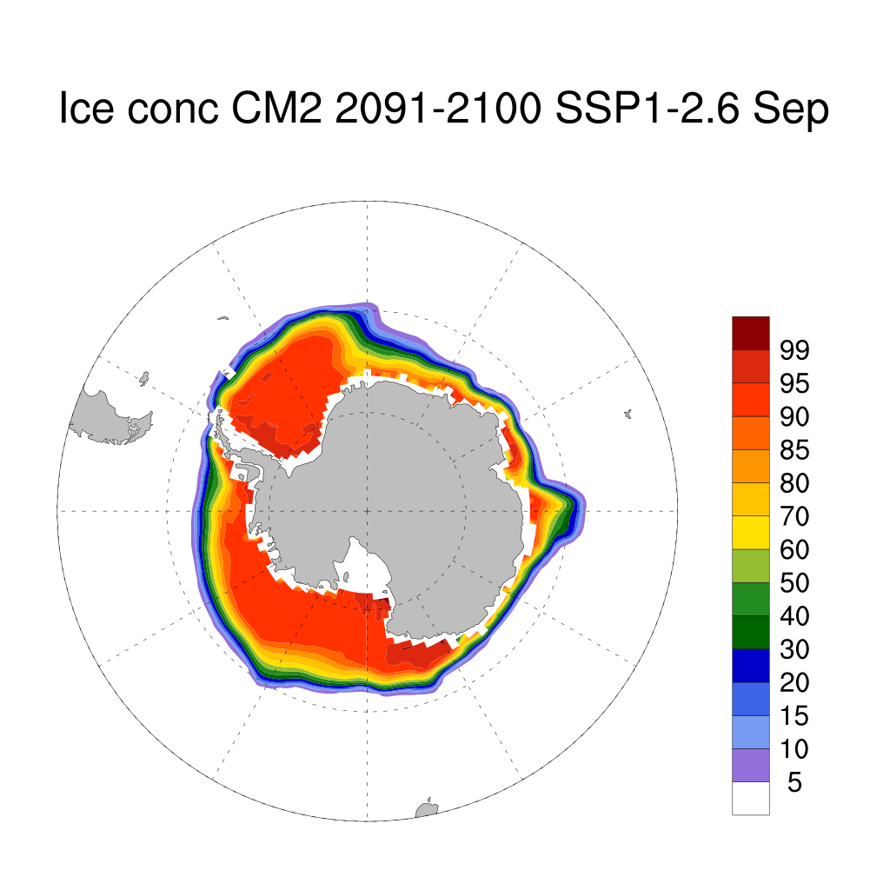
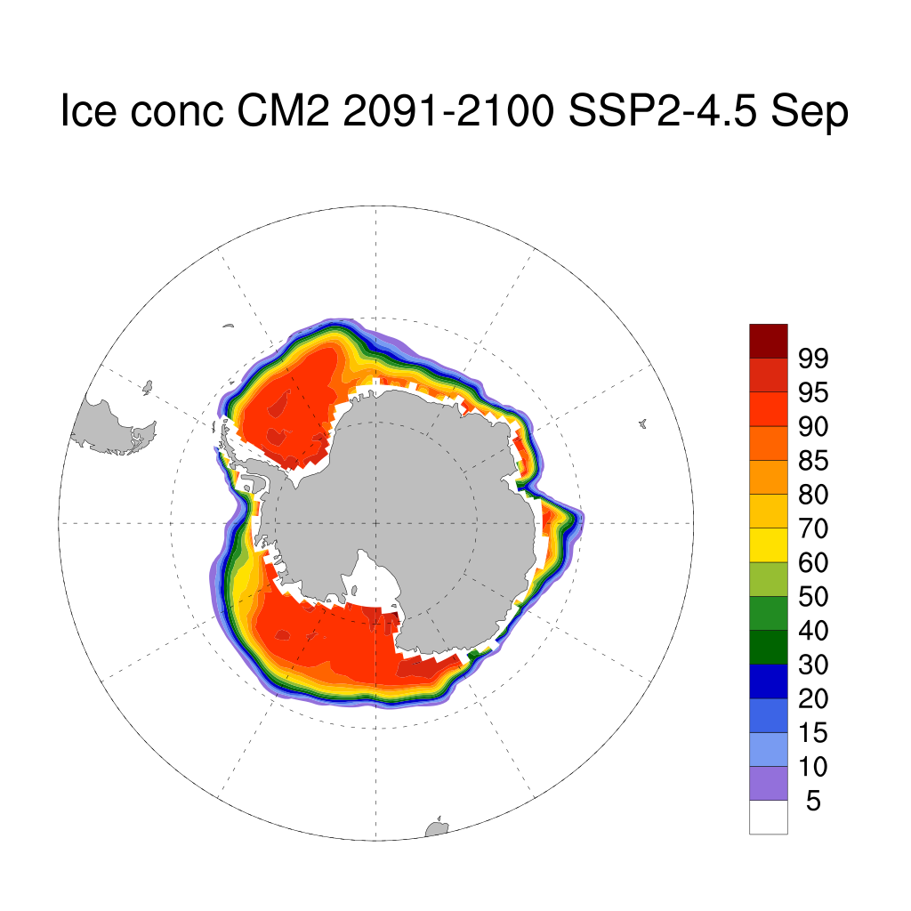

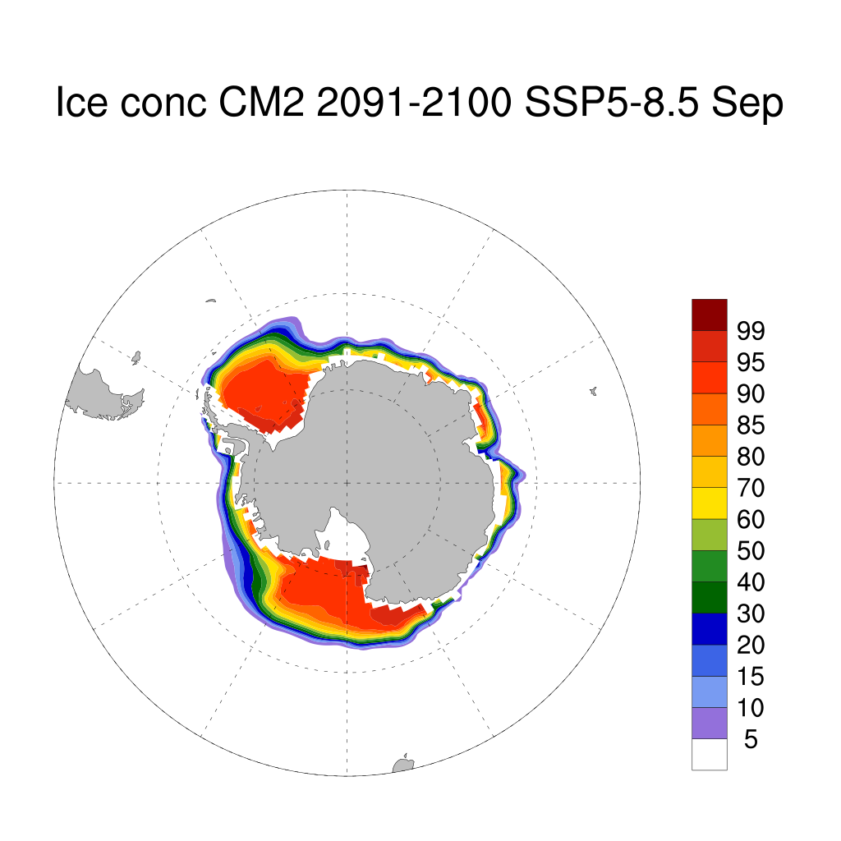
ACCESS CM2 ice climatologies for scenarios (September late winter) 2091-2100 shows minimal change for low scenario higher for SSP3-7.0, SSP5-8.5.

Slide 15
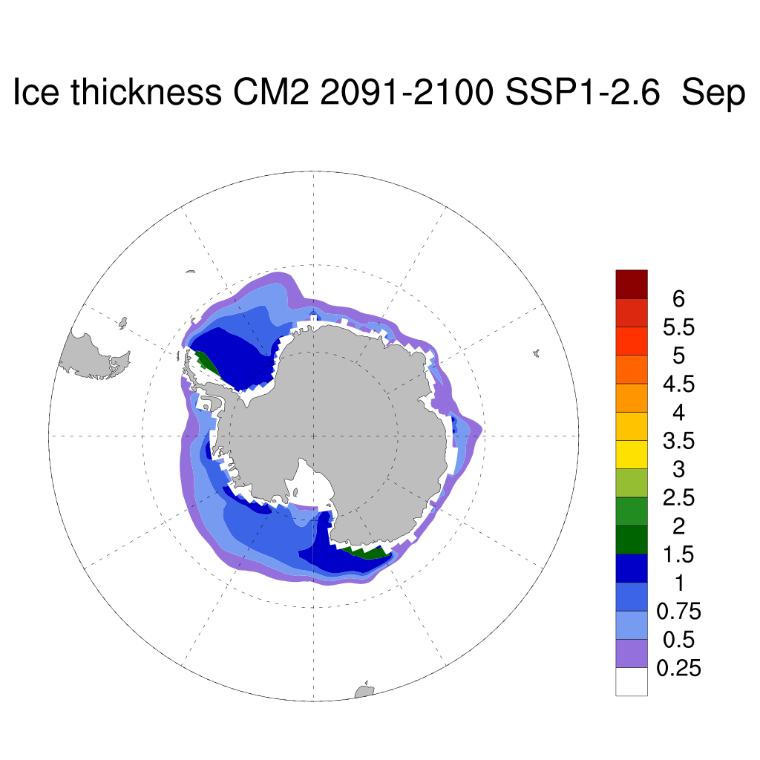
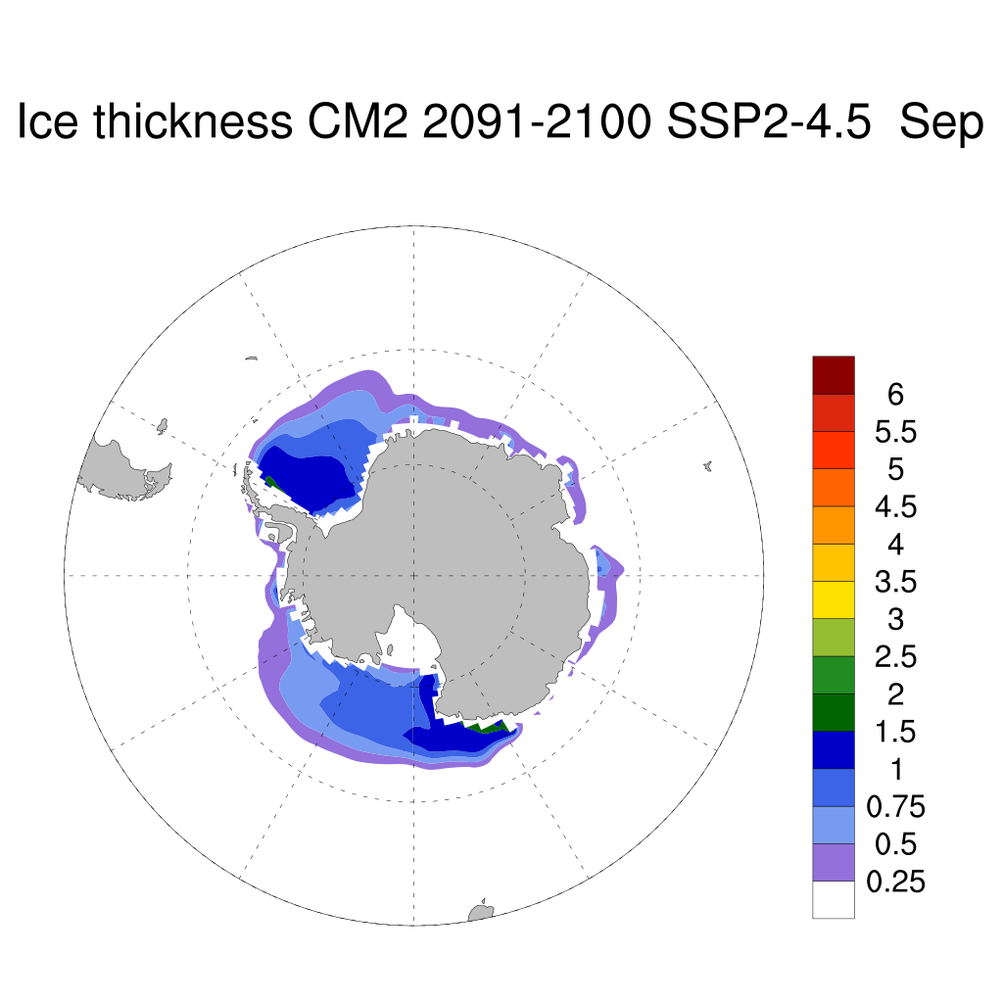
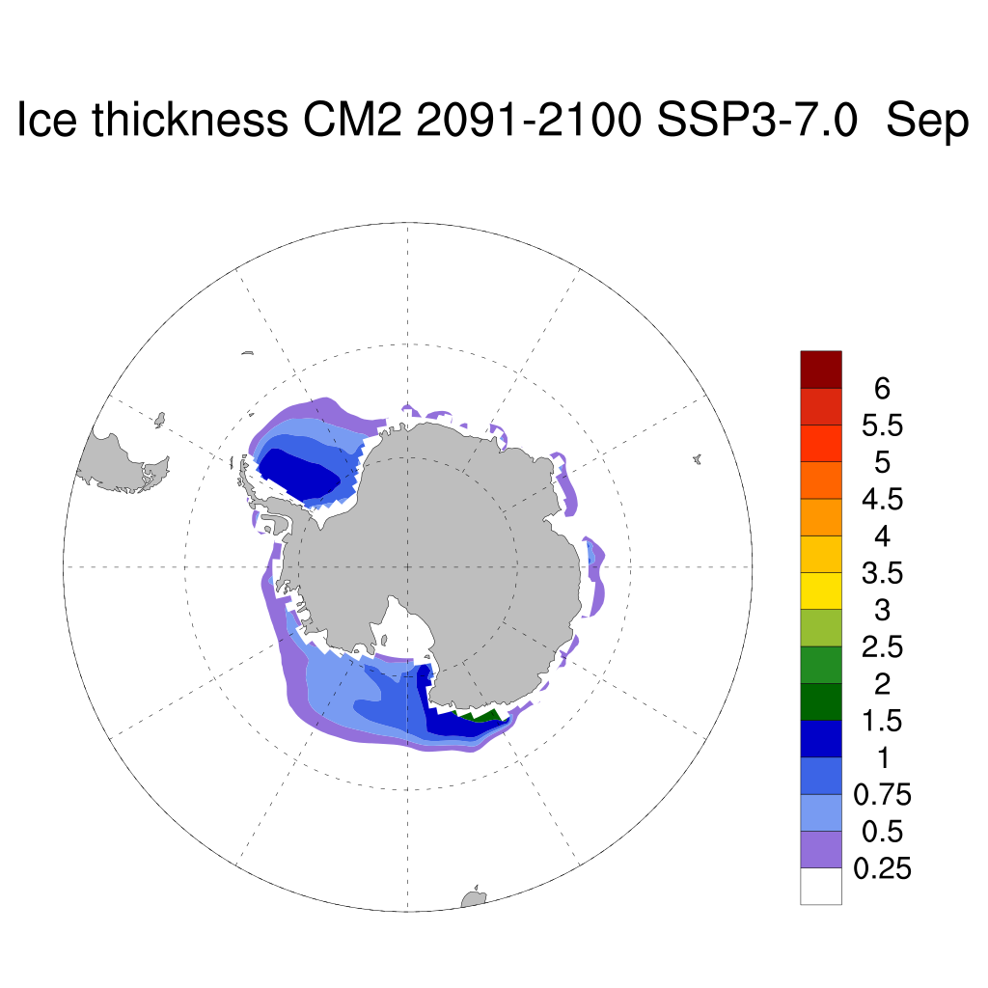
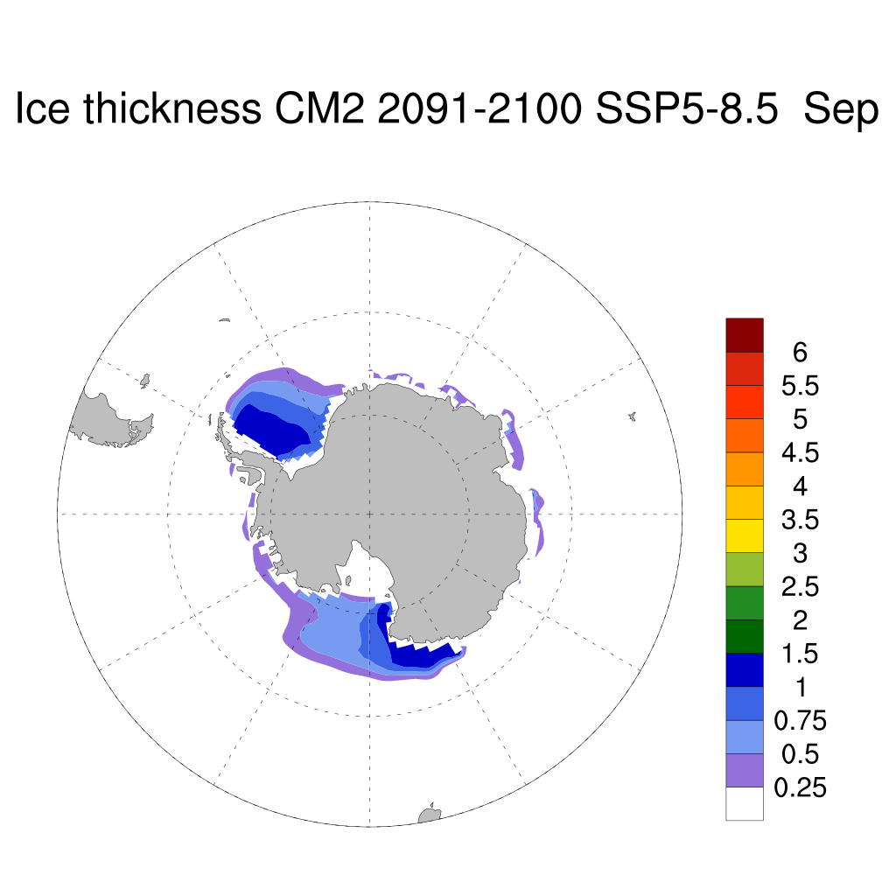
ACCESS CM2 ice thickness climatology for scenarios in September 2091-2100.

Slide 16
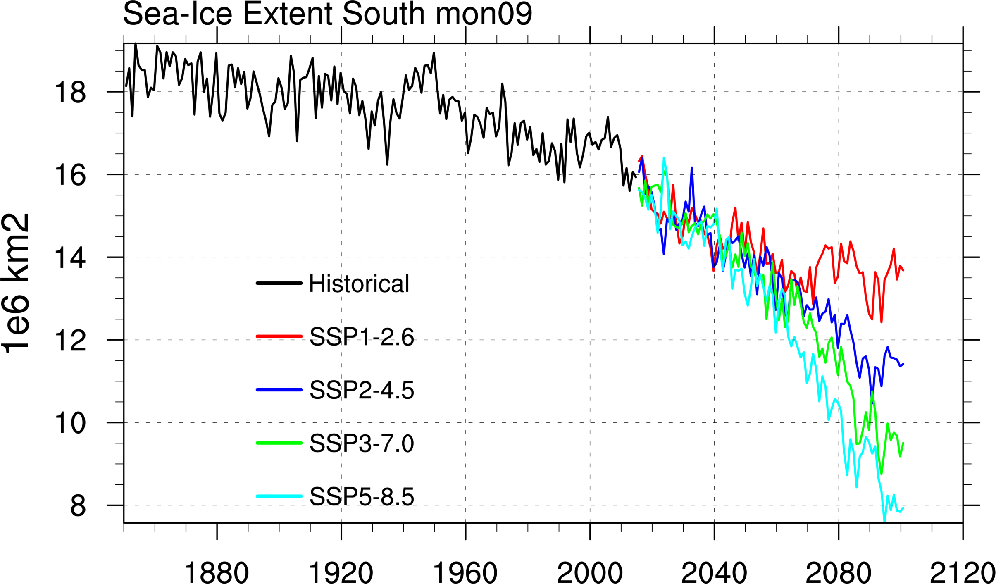
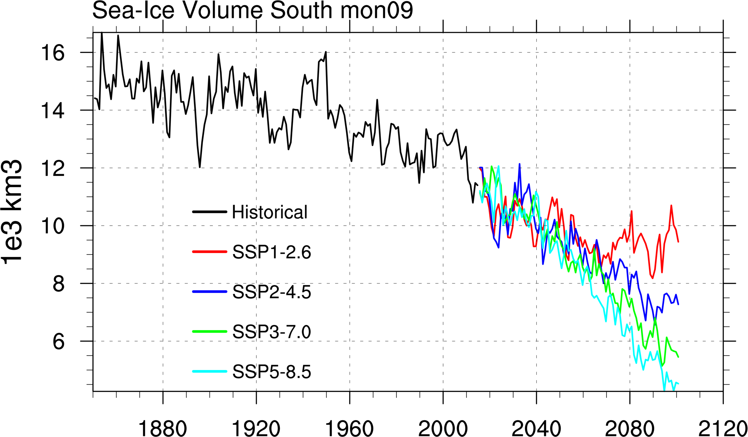
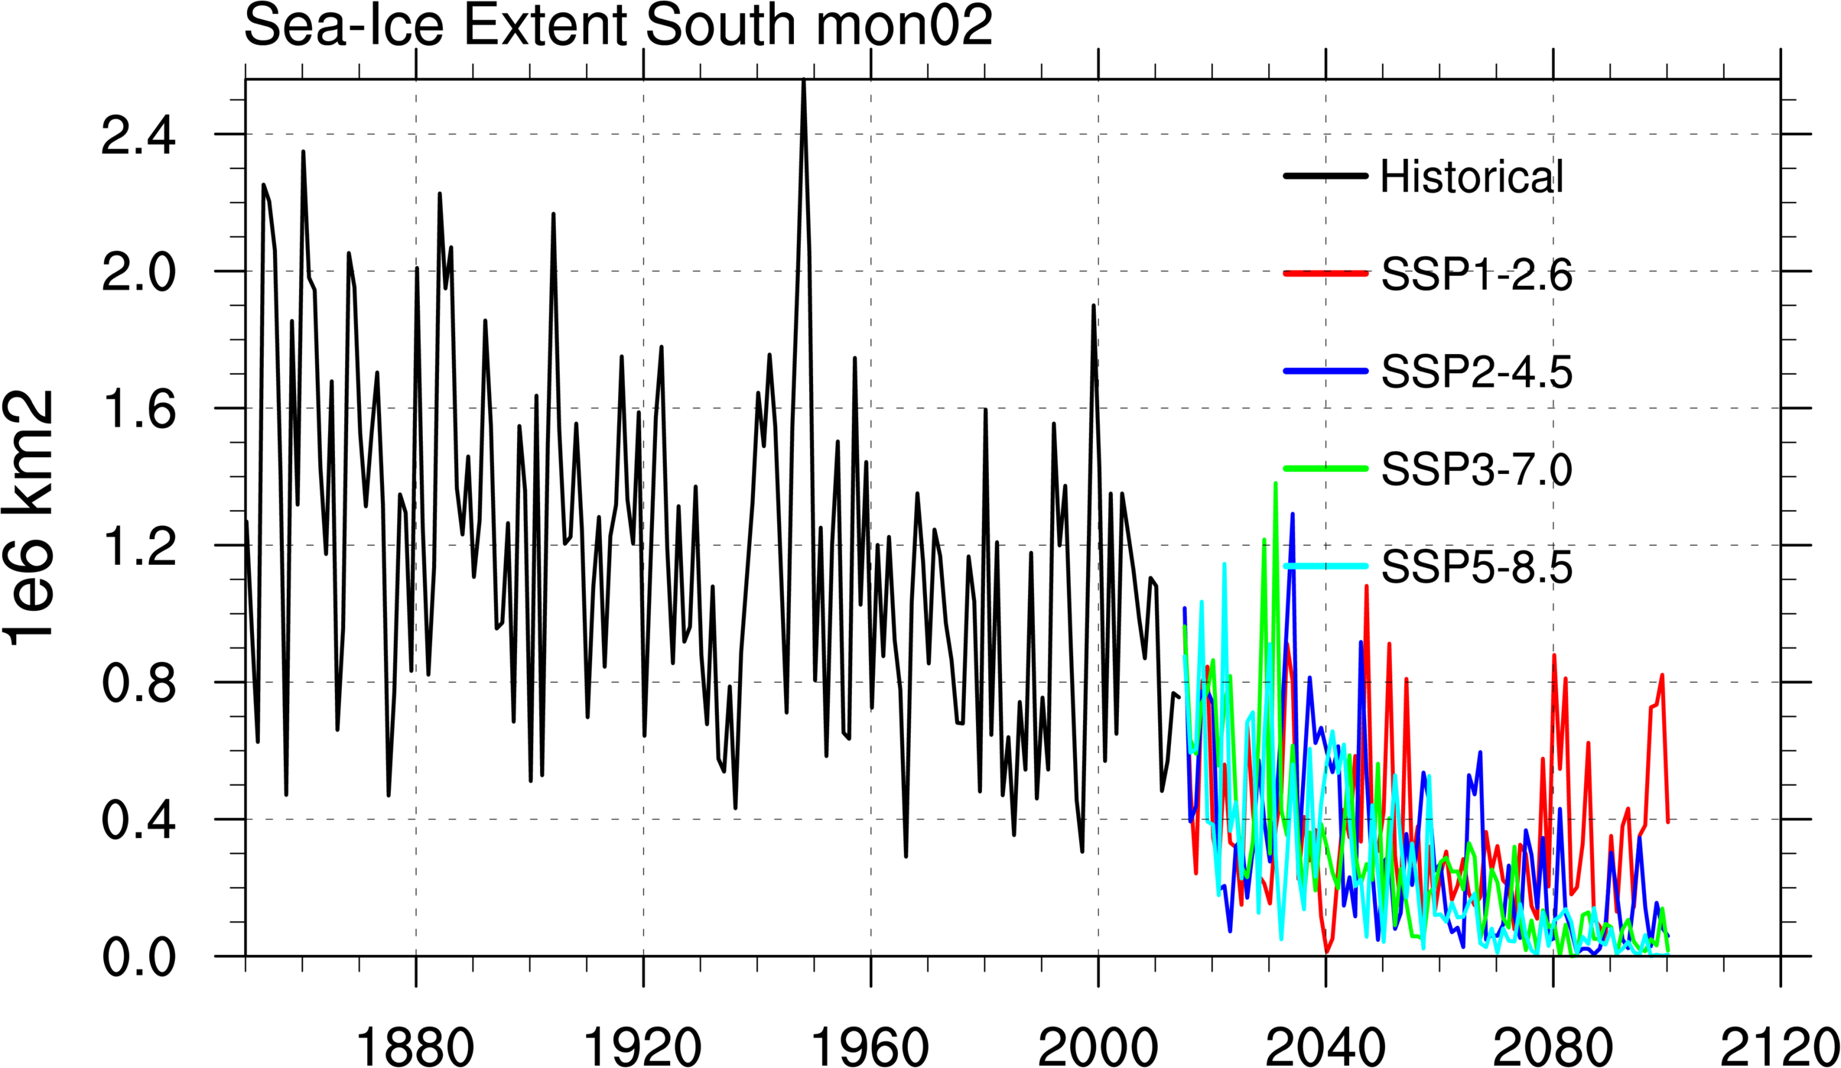
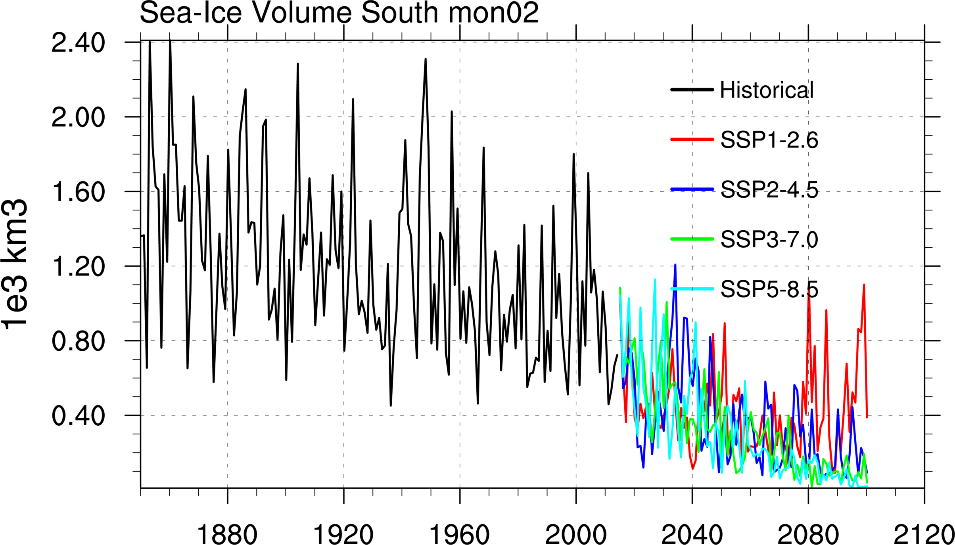
ACCESS CM2 time series for ice extent and ice volume for scenarios.

Slide 17
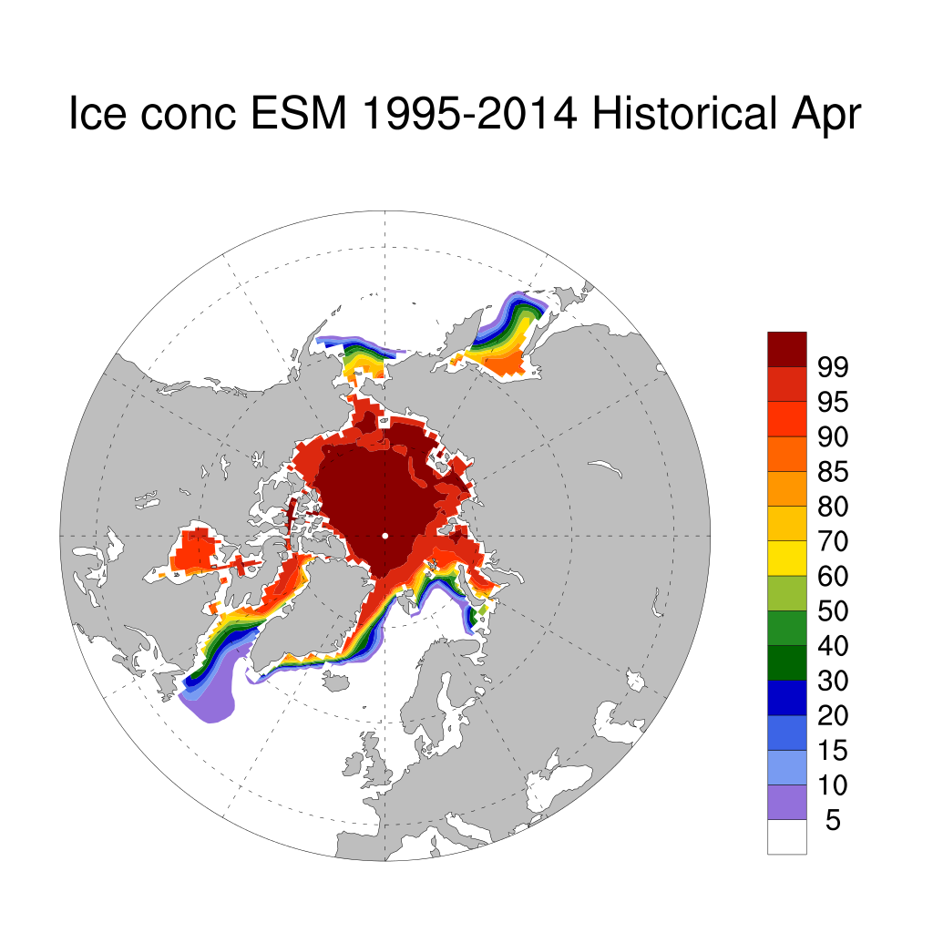
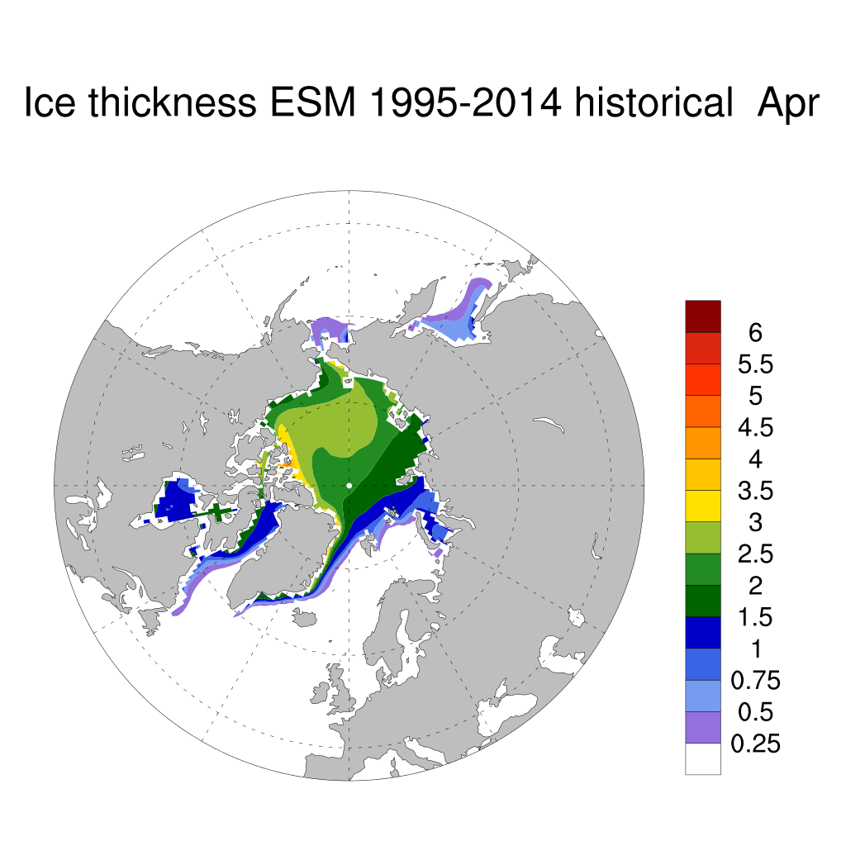
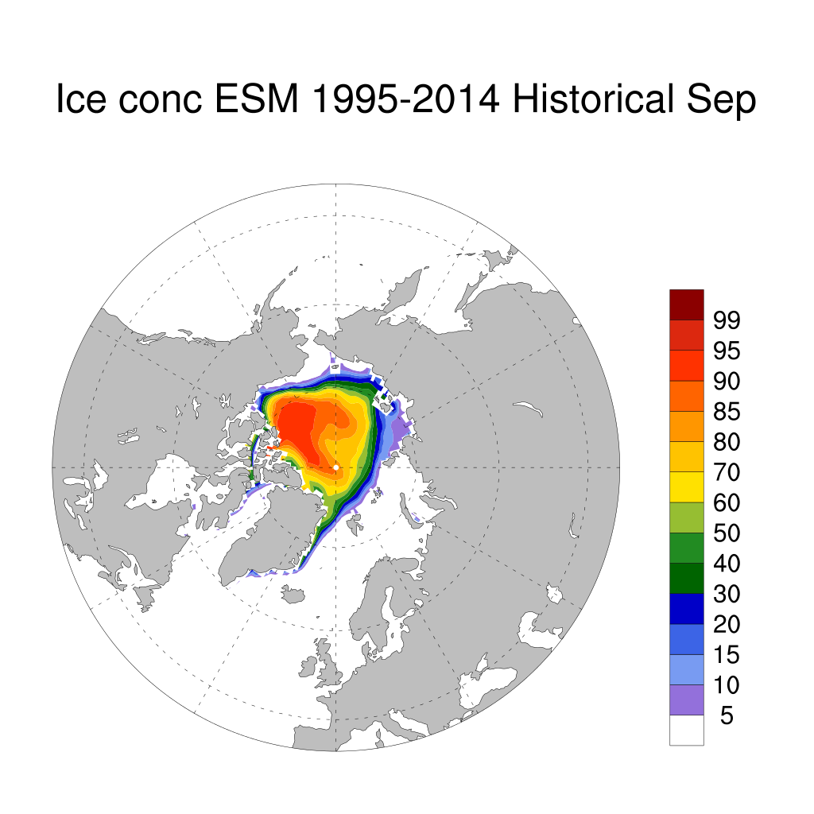
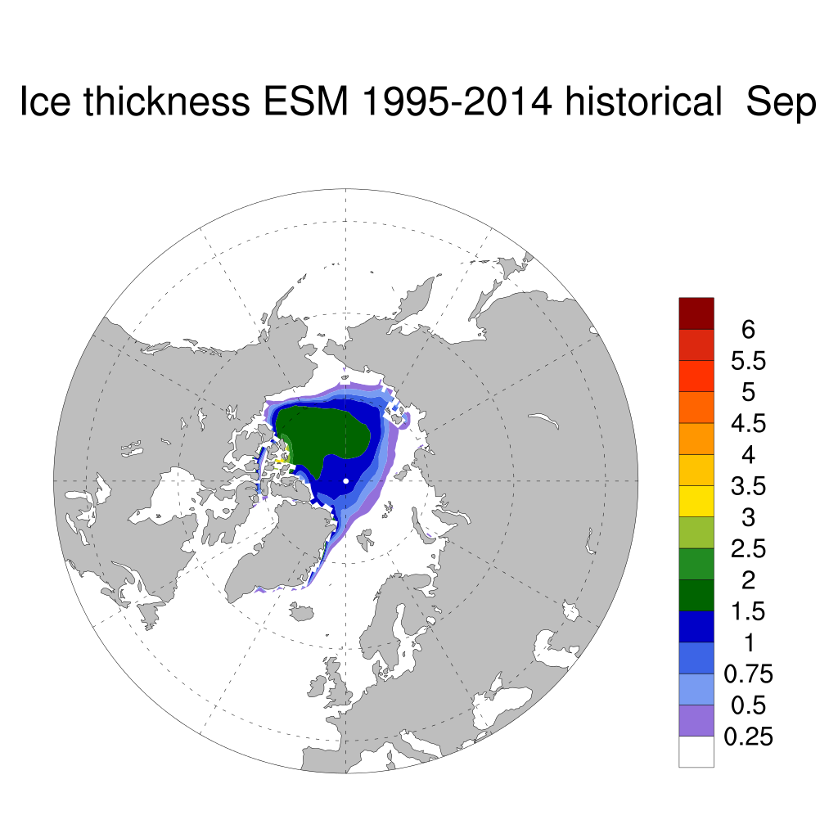
ACCESS ESM1.5 historical ice climatology 1995-2015. Ice thickness is ~50cm less than in ACCESS CM2 even with the higher albedos.

Slide 18
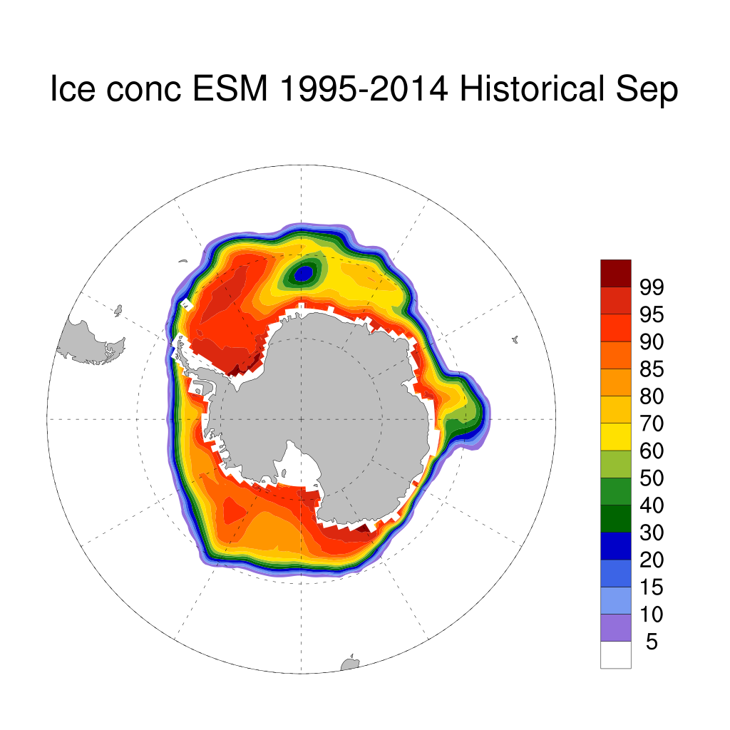
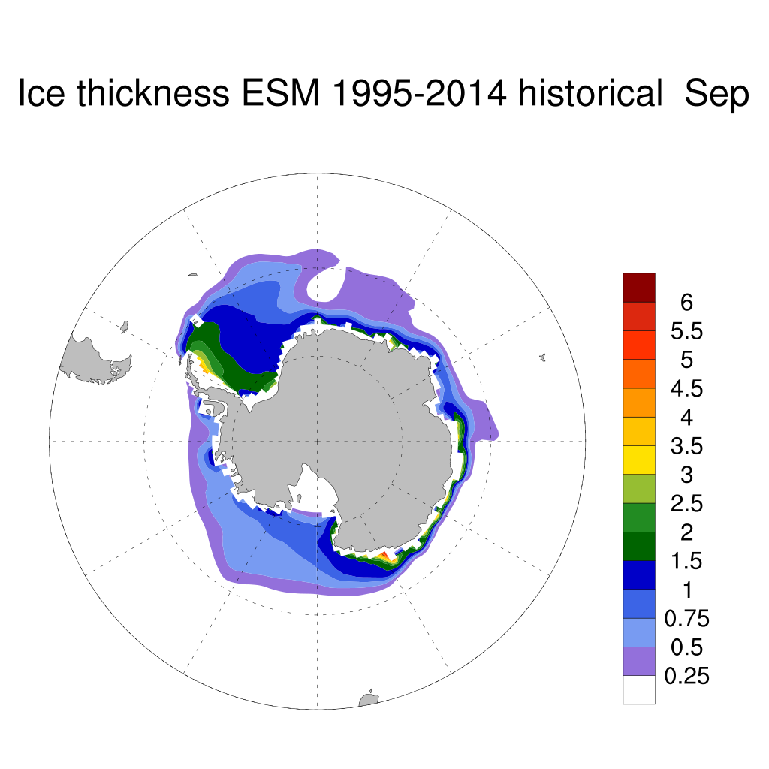
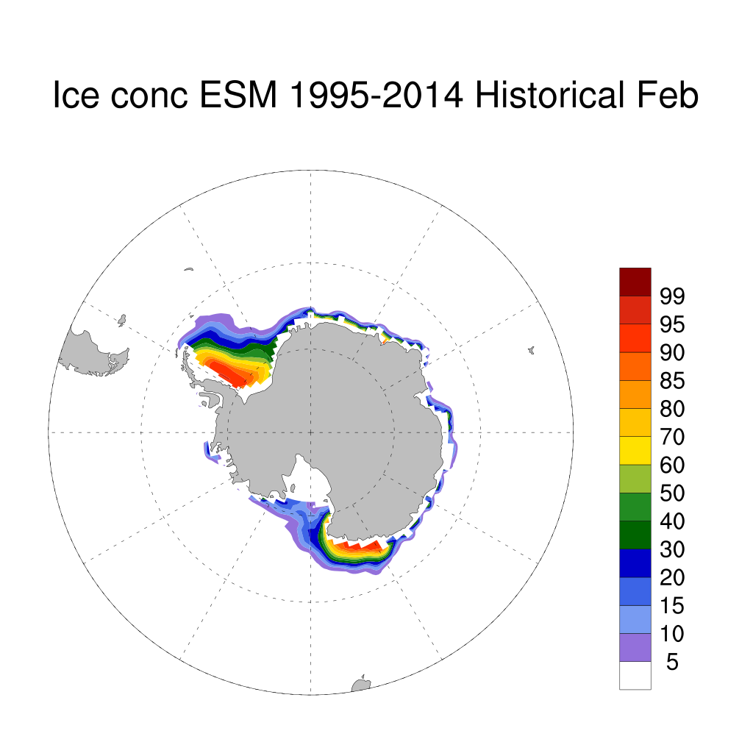

ACCESS ESM1.5 ice model climatology historical run (1995-2014). Polynya regularly forms in Weddell sea over area of convection. In ACCESS CM2, neutral physics parameters adjusted to prevent this and pseudo iceberg scheme freshens and cools ocean to make it more stratified.

Slide 19



ACCESS ESM1.5 ice concentration climatology for scenarios September 2051-2060.
More ice present than ACCESS CM2 despite lower ice thickness in piControl and historical runs due to lower climate sensitivity, ice disappears entirely in summer in upper 2 scenarios by 2100.

Slide 20



ACCESS ESM1.5 ice concentration in summer in 2091-2100 in scenarios (still present, in 2051-2060 they could not be distinguished, this is the result of the thick ice near the coast due to the high albedo parameters used in ACCESS ESM1.5.

Slide 21



ACCESS ESM1.5 ice thickness climatology for scenarios in September (2091-2100).

Slide 22
Conclusions
SH Sea Ice Climatology of both models have biases ACCESS CM2 too little ice, ACCESS ESM1.5 too much ice.
The Arctic has dramatic response in the scenario runs in both models with almost all ice loss by 2040’s in all scenarios in ACCESS CM2 and the higher scenarios in ACCESS ESM1.5. This is in line with other CMIP6 models (Met office, NCAR) with high climate sensitivity, but stronger than seen in CMIP5 when RCP2.6 retained Arctic ice cover.
In SH ice (especially summer) we get divergent results between the models, due to the different model biases in the control and historical runs and the high albedo parameterization in ACCESS ESM1.5 which is a legacy of ACCESS1-3 CABLE implementation.

